Slide 1
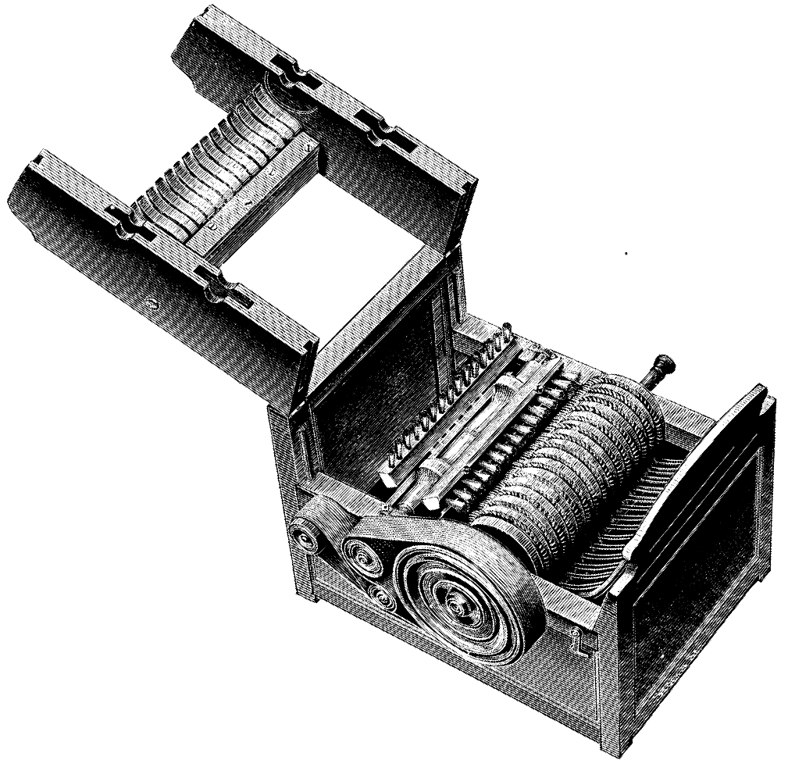
How did this invention cause an increase in slavery?

Slide 2
Industry Changes Work
Cottage industry—manufacturers supply materials, goods made in homes
Entrepreneurs like Francis Cabot Lowell open weaving factories in MA
- by 1830s Lowell and partners have 8 factories, 6,000 employees

Slide 3
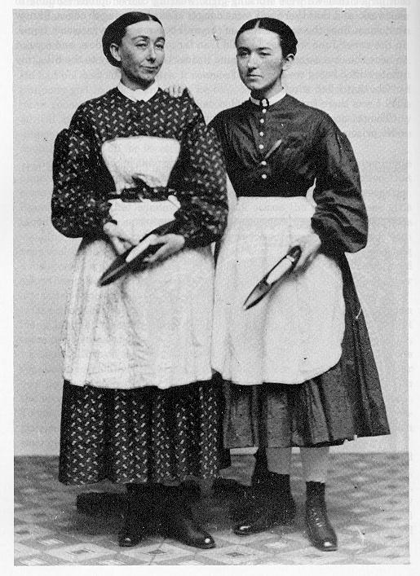
The Lowell Mill
• Most mill workers are unmarried
farm girls
- under strict control of female supervisor
•Females can be paid lower wages than men

Slide 4
Factory pay better than alternatives—teaching, sewing, domestic work
• Most girls stay at Lowell only for a few years and take new ideas back to their homes

Slide 5
Conditions at Lowell
• Work 12 hours in heat, dark, poor ventilation:
- causes discomfort, illness
• Conditions continue to deteriorate; 800 mill girls conduct a strike:
- work stoppage to force employer to respond to worker demands

Slide 6
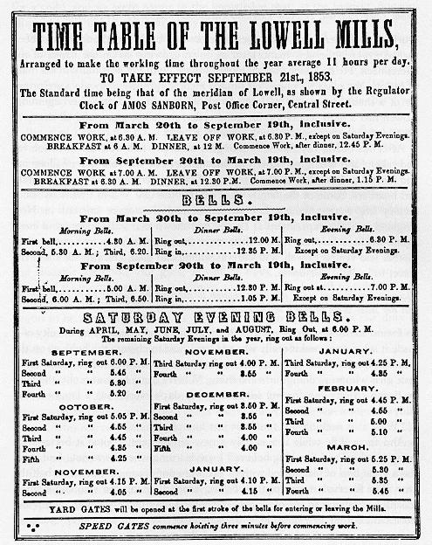
From your worksheet, highlight or underline 5 rules women must follow at the Hamilton Company.

Slide 7
Strikes at Lowell
• 1834, strike over pay cut; 1836, strike over higher board charges
• Company prevails both times, fire strike leaders
• 1845, Lowell Female Labor Reform Association founded

Slide 8
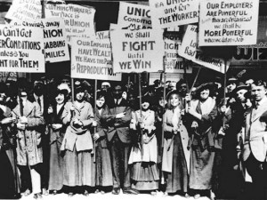

Slide 9
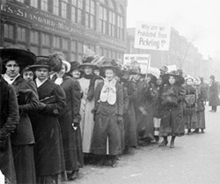

Slide 10
Workers Seek Better Conditions
Workers Unionize
Artisans form unions; begin to ally selves with unskilled workers
1830s–1840s, 1–2% of workers organized, dozens of strikes
- employers use immigrants as strikebreakers

Slide 11
National Trades’ Union
1830s, unions for same trade unite to standardize wages, conditions
1834, organizations from 6 industries form National Trades’ Union
courts declare strikes illegal

Slide 12
Court Backs Strikers
In 1842, Massachusetts Supreme Court upholds right to strike

