Slide 1
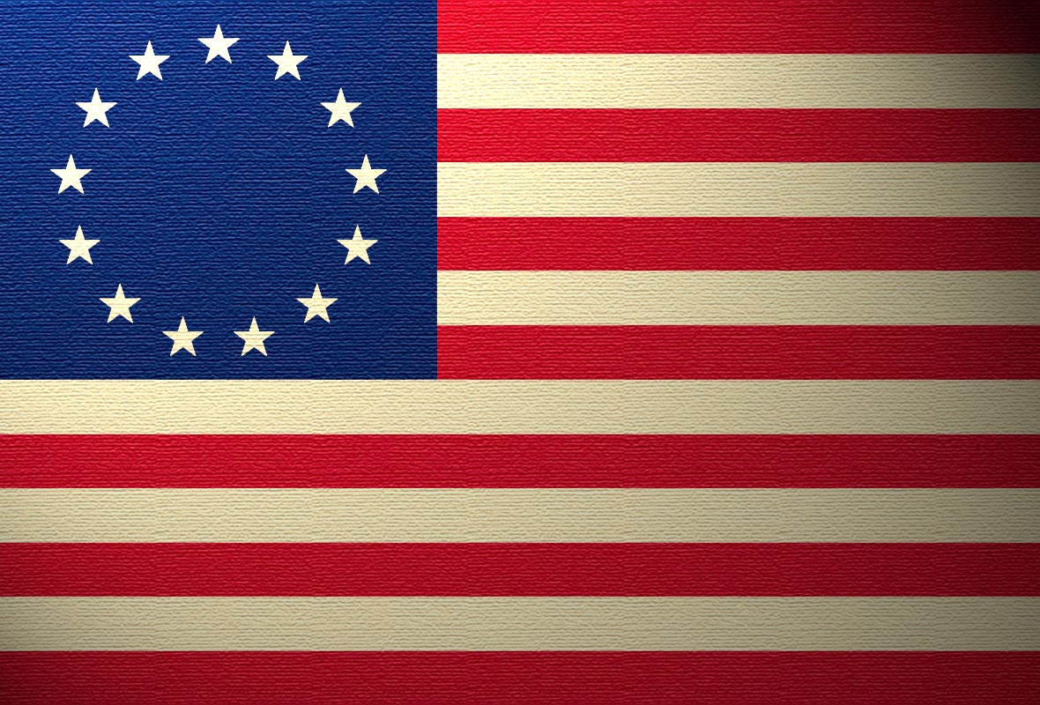
Winning the War

Slide 2
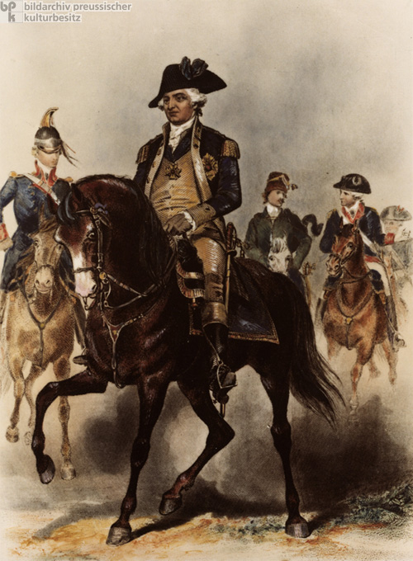
Feb. 1778 – Frederick von Steuben volunteers his services to Washington.
Trained Soldiers To:
Stand at attention.
Execute field maneuvers
Fire and reload quickly.
Handle Bayonets
Result = Effective Fighting Force

Slide 3
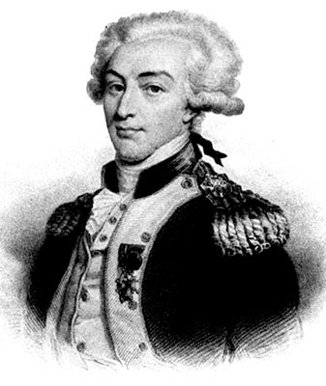
Marquis de Lafayette
- 20 year old French aristocrat who led a command in Virginia in the last years of the war. Became a close friend of Washington.

Slide 5
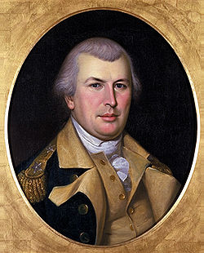
-After the Battle of Saratoga the British shifted their forces South and would try to slowly fight their way back north.
-After the British capture Charles Town, S.C. Washington orders Nathanael Greene to march south and harass Corwallis.

Slide 6
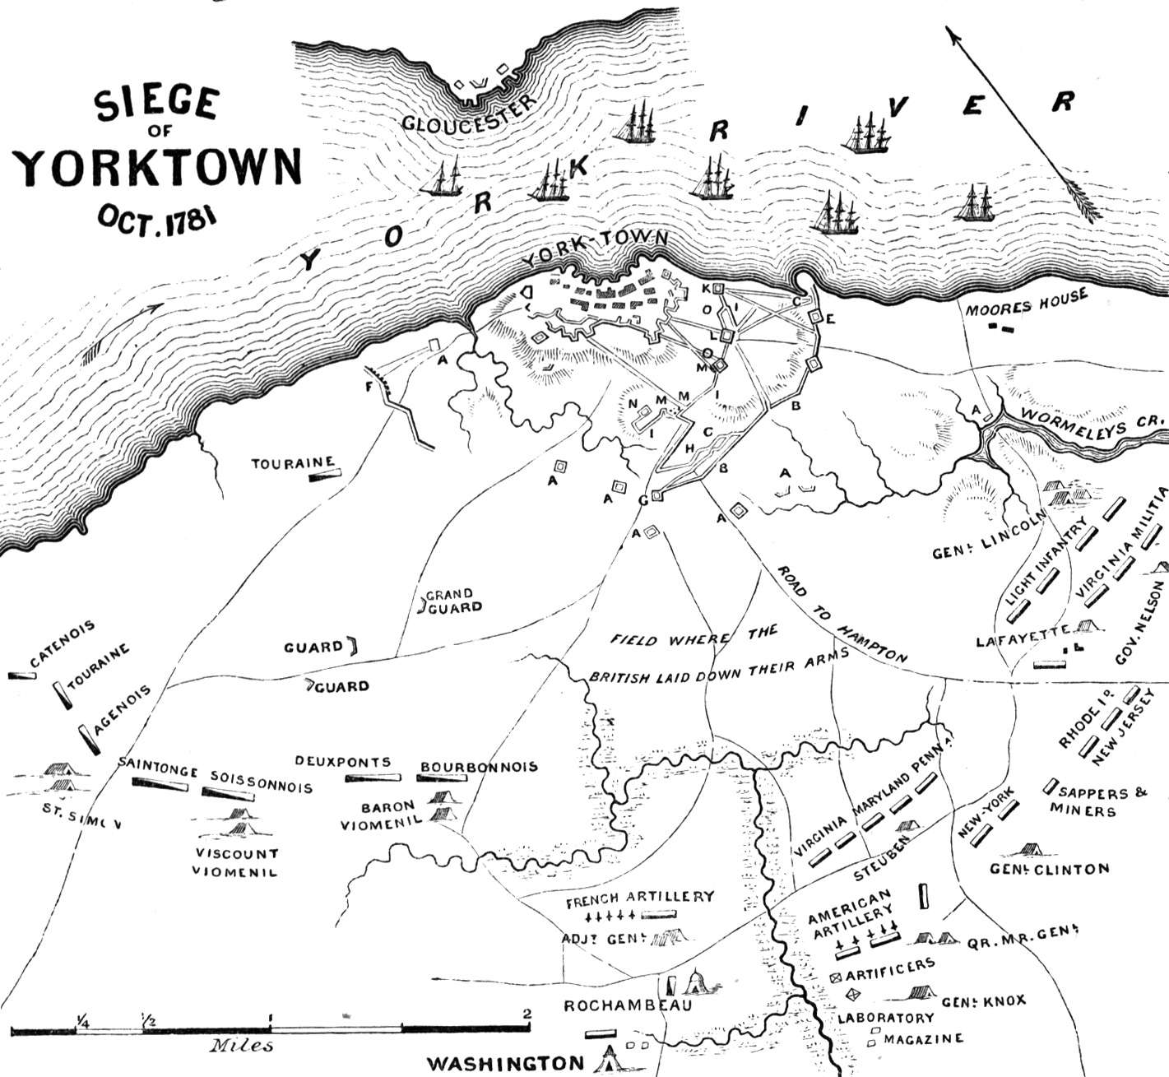
-Cornwallis fights his way to Virginia.
Makes the fatal mistake by setting up camp in Yorktown.
-American and French forces attack Cornwallis for 3 weeks.
Oct. 17, 1781 – Cornwallis surrenders

Slide 7
Quotes from General Cornwallis:
On September 29, Cornwallis assured Clinton, “I . . . have no doubt, if relief arrives in any reasonable time, York and Gloucester will be both in possession of his Majesty’s troops”.
Who wrote the quote? __________________________________________________________
Date or time of the quote ________________________________________________________
Important information from quote __________________________________________________________________________________________________________________________________________________________________________________________________________________________________________________________________________________________________________________________________________________________________________________________________________________
What emotions are they feeling? ________________________________________________________________________________________________________________________________________________________________________________________________________________________________________________________________________________________________________________________

Slide 8
By October 10, though, Cornwallis pleaded that “nothing but a direct move to York River—which includes a successful naval action—can save me. . . . We have lost about seventy of our men and many of our works are considerably damaged . . . we cannot hope to make a very long resistance. P.S. 5 p.m. Since my letter was written [at 12 p.m.] we have lost thirty men.”
Who wrote the quote? _______________________________________________________
Date or time of the quote ______________________________________________________
Important information from quote ____________________________________________________________________________________________________________________________________________________________________________________________________________________________________________________________________________________________________________
What emotions are they feeling? ____________________________________________________________________________________________________________________________________________________________________________________________________________________________________________________________________________________________________________

Slide 10
Cornwallis did not show up to the surrender
Ceremonies. He did not attend the surrender ceremony because he was not feeling well.
– His men tried to surrender to the French, but the French
commander forced them to surrender to Washington
The Treaty of Paris of 1783 was signed which did the
following:
– Britain recognized the United States as an independent
nation and withdrew all troops
• The US territory extended from the Atlantic Ocean to the Mississippi
River

Slide 11
