Slide 1
“The lessons that lie along the Trail of Tears are more than a chapter in a history book. They are the lessons that teach future generations to celebrate diversity rather than to push it into the farthest corners of our country,” said Congressman Berry. “Only by experiencing this tragedy can we begin to understand why so many Native Americans
died along this trail.”
“It is unacceptable that such a critical part of our history remains a patchwork of
missing pieces,” said Congressman Berry. “As Americans, we need to capture this part of
history so we never forget the stories of families torn apart at the hands of our country.”

Slide 2
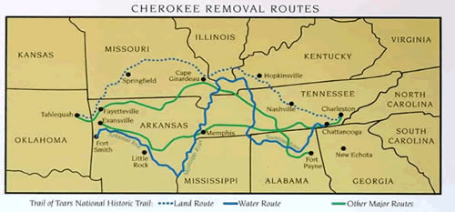
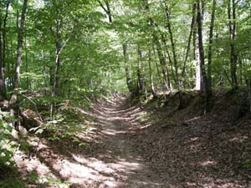
Arkansas
River
Tennessee
River
Mississippi
River
The Trail in Village Creek State Park, Arkansas.

Slide 3
-Following the Indian Removal Act Jackson forced Native American Tribes to sign treaties that gave up their land.
5 “civilized tribes”:
1. Cherokee
2. Choctaw
3. Seminole
4. Creek
5. Chickasaw
*Cherokee were the only ones to try to win fair treatment in the U.S. courts

Slide 4
Supreme Court Case Worcester v. Georgia
-Cherokee were represented by Samuel Worcester
- Court ruled in favor of Cherokee saying that Georgia did not have a right to regulate the Cherokee nor invade their lands.
President Jackson replied “John Marshall has made his decision; now let him enforce it.”
- In 1835 the Treaty of New Echota gave up the remaining land the Cherokee owned
1838 approx. 20,000 Cherokee remained
New President martin Van Buren orders their forced removal.
Result was the Trail of Tears – Oct. – Nov. 1838 (800 mile journey)

Slide 5
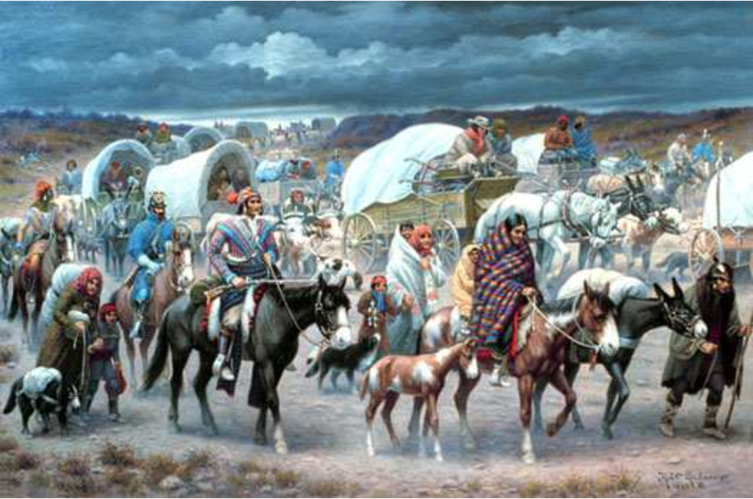

Slide 6
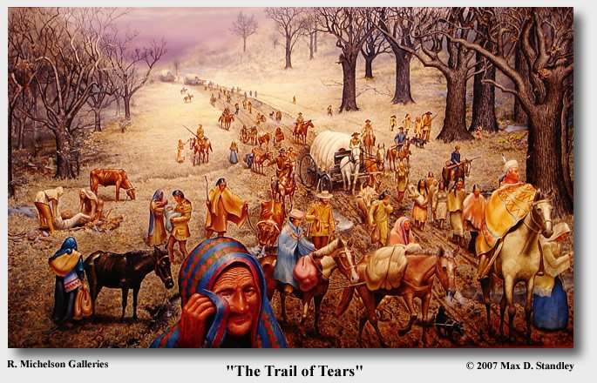

Slide 7
