Slide 1
Warm Up Questions
What do you think is the most significant technological development of the last century?
How has the development of this technology changed the way Americans live?

Slide 2
The Market Revolution
Technological changes create greater interaction and more economic diversity among the regions of the nation.

Slide 3
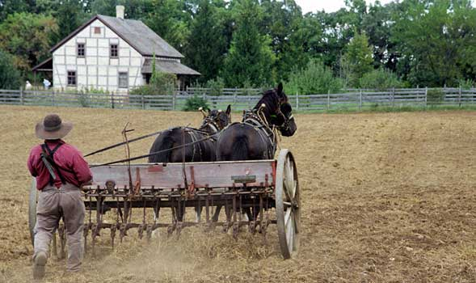
Early 1800s farm families self-sufficient; only buy what cannot make

Slide 4
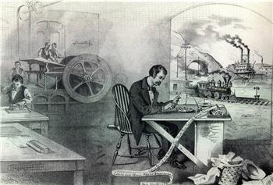
Market revolution—people buy and sell goods rather than make them

Slide 5
Erie Canal and Other Internal Improvements
Railroads not yet in common use; first steam engine built 1825
Many states build turnpikes, toll roads pay for themselves
Federal government funds highways to connect different regions

Slide 6
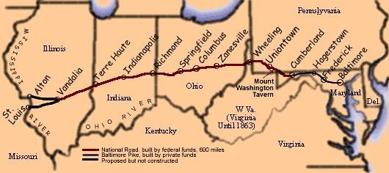
1838, National Road extends from Cumberland, MD to Vandalia, IL

Slide 7
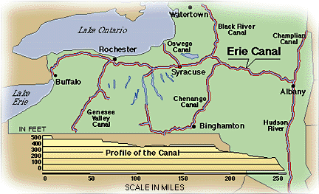
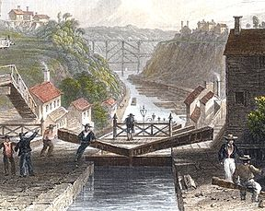
Erie Canal links Hudson River to Lake Erie: Atlantic to Great Lakes

Slide 8
Impact on Transportation
1807, Robert Fulton’s steamboat goes 150 miles up Hudson in 32 hours
By 1830 steamboats on western rivers cut freight costs, speed travel
Water transport key for moving heavy machinery, raw materials

Slide 9
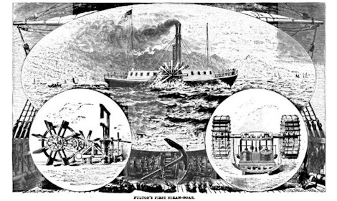

Slide 10
Erie Canal heavily used, lowers cost; dozens of canals follow
Canals connect Midwest farmers to Northeast and world markets

Slide 13
An Excerpt from the Journal of Thomas S. Woodcock
". . . These Boats have three Horses, go at a quicker rate, and have the preference in going through the locks, carry no freight, are built extremely light, and have quite Genteel Men for their Captains, and use silver plate. The distance between Schenectady and Utica is 80 Miles, the passage is $3.50, which includes board. There are other Boats called Line Boats that carry at a cheaper rate, being found for 2/3 of the price mentioned. They are larger Boats, carry freight, have only two horses, and consequently do not go as quickly, and moreover have not so select a company. Some boats go as low as 1 cent per Mile, the passengers finding themselves.
The Bridges on the Canal are very low, particularly the old ones. Indeed they are so low as to scarcely allow the baggage to clear, and in some cases actually rubbing against it. Every Bridge makes us bend double if seated on anything, and in many cases you have to lie on your back. The Man at the helm gives the word to the passengers: "Bridge," "very low Bridge," "the lowest in the Canal," as the case may be. Some serious accidents have happened for want of caution. A young English Woman met with her death a short time since, she having fallen asleep with her head upon a box, had her head crushed to pieces. Such things however do not often occur, and in general it affords amusement to the passengers who soon imitate the cry, and vary it with a command, such as "All Jackson men bow down." After such commands we find few aristocrats."

