Slide 1
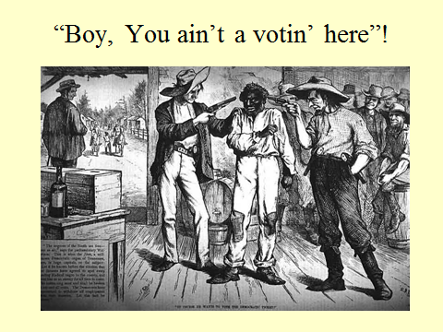

Slide 2
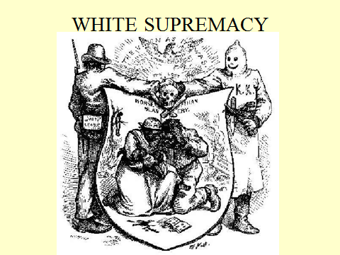

Slide 3
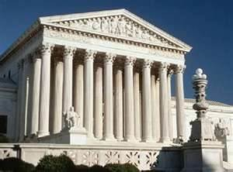
Civil Rights Setbacks in the Supreme Court

Slide 4
Slaughterhouse Cases
1873 (14th Amendment)
Ruling:
Most civil rights were ruled to be state, rather than federal, rights and therefore unprotected by the 14th Amendment

Slide 5
U. S. v. Cruikshank
1876 (14th Amendment)
Ruling:
The 14th Amendment was ruled not be grant the federal government power to punish whites who oppressed blacks.

Slide 6
U. S. v. Reese
1876 (15th Amendment)
Ruling:
The 15th Amendment was determined not to grant voting rights to anyone, but rather restrict types of voter discrimination.

Slide 7
Assignment
Read and compare the chart on page 400 in the textbook. Then Answer the following questions:
1. How did Reconstruction improve the lives of African Americans?
2. Was Reconstruction a success or failure? Support your answer with information from your text and notes.

