Slide 2
Identify the following in your notebook:
Sugar Act
Quartering Act
Townshend Revenue Act
Stamp Act
Tea Tax
Sons of Liberty

Slide 3
Road to a Revolution
Conflict between Great Britain and the American Colonies grows over issues of taxation, representation, and liberty.
In order to pay for the French and Indian War the British tax the colonies.

Slide 4
Sugar Act (1764)
Prime Minister George Greenville suspected the colonists were smuggling goods. In response he passed the Sugar Act.
Act did 4 things:
Halved the cost on foreign-made molasses
Placed taxes on certain products
Allowed prosecutors to try smuggling cases in a more harsh court.
Only the rich could afford sugar

Slide 5
Stamp Act
March 1765 – act was passed requiring colonists to purchase special stamped paper for every legal document, license, newspaper.
Secret resistance group was formed called “Sons of Liberty” founded by Sam Adams

Slide 6
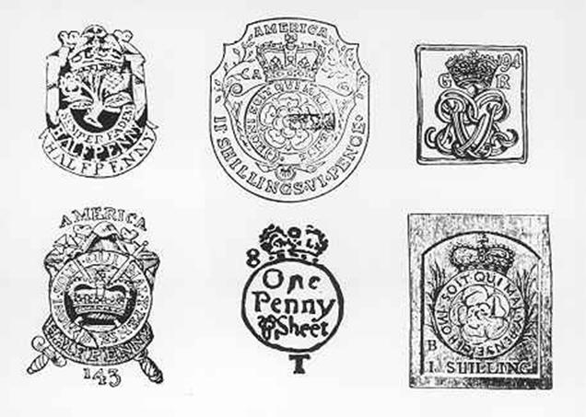

Slide 7
Parliament would get rid of the Stamp Act but passed another tax in 1767 called the Townshend Acts (Taxes put on imported materials)
Colonists protested “taxation without representation”

Slide 8
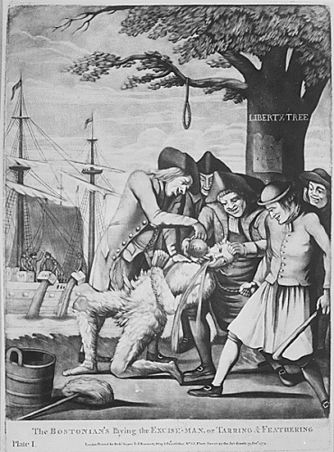

Slide 9
http://www.youtube.com/watch?v=hFWZ925zK0ASlide 8

