Slide 1
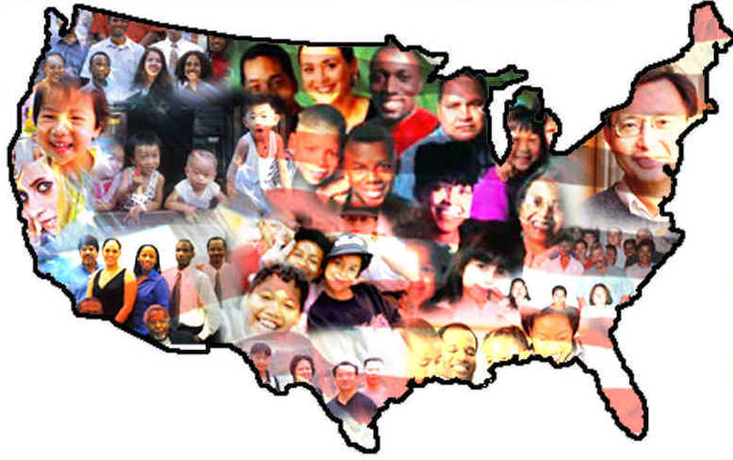
Name 3 reasons why people come to America.

Slide 2
Sources of Immigration, 1840 -1860

Slide 5
Causes of Immigration
Severe food shortages from 1829 – 1830 caused Germans to leave and migrate to the U.S. This was due to poor weather conditions.
The Potato famine in Ireland in 1848 forced the Irish to come to the United States.

Slide 6
Irish Potato Famine
A few days after potatoes were dug from the ground, they began to turn into a slimy, decaying, blackish "mass of rottenness.“
Potato disease commonly known as potato blight
Approx. 1 million deaths.

Slide 8
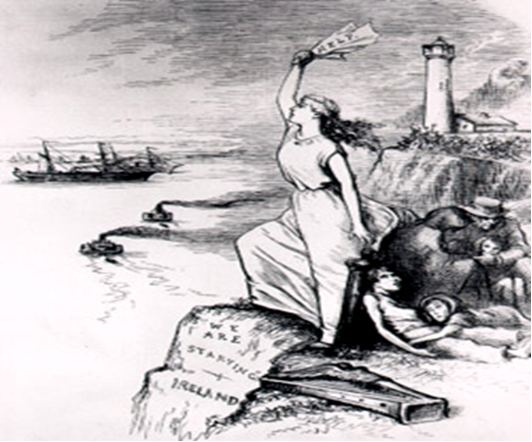

Slide 9
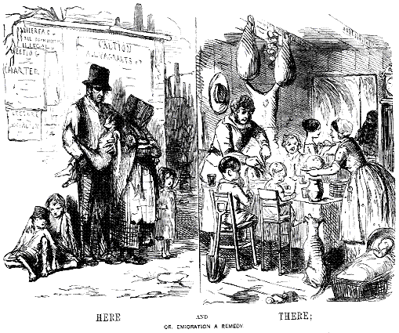

Slide 10
Homework Assignment
Create a personal narrative or diary of an immigrant who came to the United States.
Focus On:
What events led the individual to leave Northern Europe to emigrate to the United States?
The to U.S. and its hardships.
What the immigrant expects of life in America.

