Slide 1
WOULD YOU RATHER?
1. Chew a piece of toenail off a really dirty man’s foot
Lick the armpit of a man who hasn’t bathed in a week
2. Have 100 tarantulas crawling in your house.
Have 2000 crickets jumping around your room.
3. Smell horribly 24/7
Have no hands.
4. Skip Christmas for a year
Skip your birthday for a year
5. Find true love
Find a million dollars

Slide 2
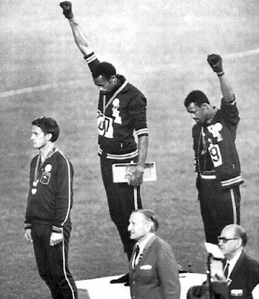
Social Activism in Sports

Slide 3
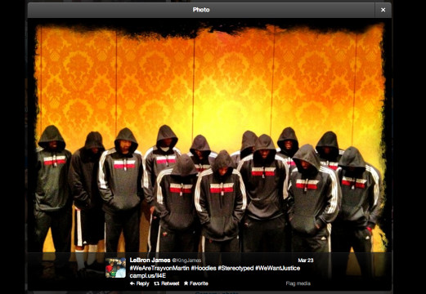

Slide 4
Professional athletes have a responsibility to be positive role models to young people.
Famous people, including professional athletes, shouldn’t have more power just because they are famous.
As a society, we should not mix politics and sports.
Athletes should “give back” to the communities in which they play and earn a living.
Athletes should stand up for political causes they believe in because their voice can reach a lot of people.
Having professional athletes take a stand about issues has no impact on that issue.

Slide 5
Step 1 – Choose one of the following names
Howard Gayle
Carlos Delgado
Tommie Smith and John Carlos
Shawn Green
Muhammad Ali
Colin Kaepernick
Ariyana Smith
Los Suns
Step 2 – Research your chosen individual and answer the following questions:
Name
What country/state are they from? What sport were they part of?
What did they protest?
Do you feel the response to their protest was positive or negative? Why?
Step 3 - Do professional athletes have a responsibility and is it their place to take stands on political and social issues?

