Slide 1
Life Under Slavery
18th century, most slaves recent arrivals, work on small farms
By 1830, majority are American, work on plantations or large farms

Slide 2
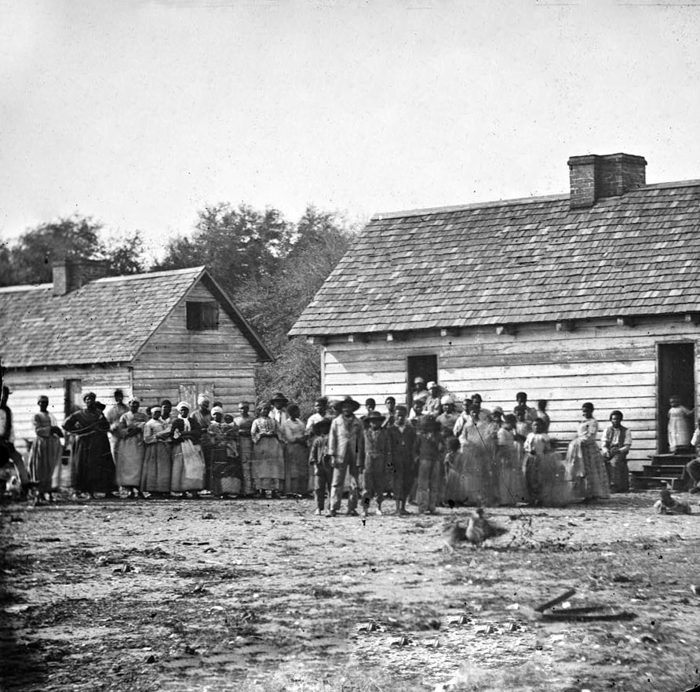
Rural Slavery
On plantations, men, women, children work dawn to dusk in fields
Slaves are whipped, have little time for food, no breaks for rest

Slide 3
Urban Slavery
Demand in southern cities for skilled black slaves
Enslaved blacks can hire themselves out as artisans
Slave owners hire out their workers to factory owners
Treatment of slaves in cities less cruel than on plantations

Slide 4
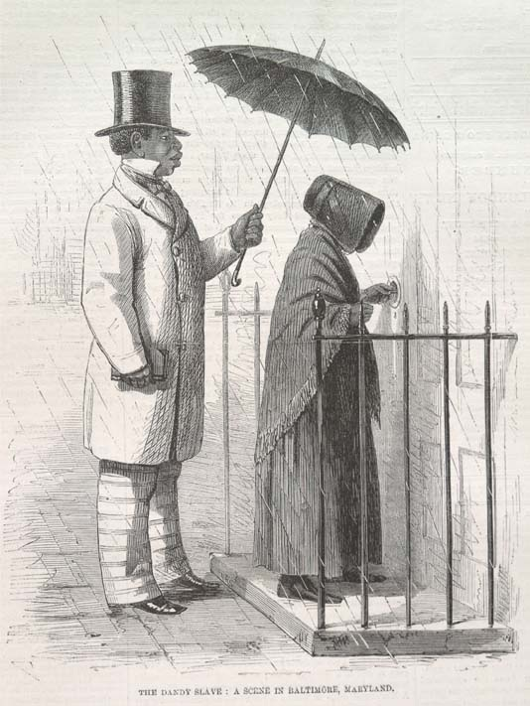
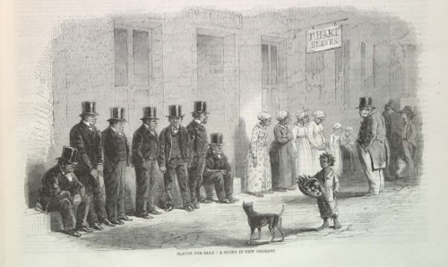

Slide 5
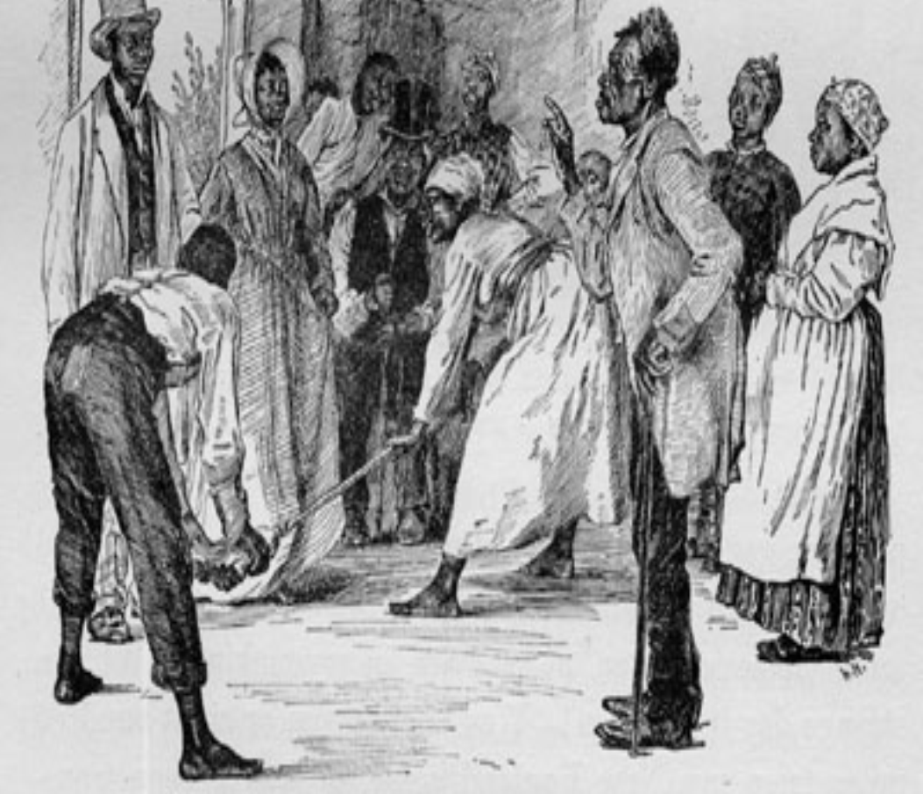

Slide 6
Forms of Slave Resistance
Running Away
Culture
Behavior
Theft
Community
Revolt
Religion
Education
Purchase Freedom

Slide 7
Slave Owners Defend Slavery
Virginia Debate
Virginia legislature debates abolition; motion not passed
Ends the debate on slavery in antebellum (pre-Civil War) South

Slide 8
Proslavery Defenses
Slavery advocates use Bible, myth of happy slave as defense
Southern congressmen secure adoption of gag rule:
- limits or prevents debate
- used on issue of slavery
- deprives citizens of right to be heard

Slide 9
Slavery and Abolition
Abolitionists Speak Out
The Resettlement Question
1820s over 100 antislavery societies advocate resettlement in Africa
Most free blacks consider themselves American; few emigrate
Whites join blacks calling for abolition, outlawing of slavery

Slide 10
Agree/Disagree:
The 1st Amendment gives us the freedom of speech, press, to petition, and assemble etc…and the South should not be allowed to ban the spreading of anti-slavery sentiment in their region, whether it be in the form of letters, newspaper articles, petitions, etc…

Slide 11
Agree/Disagree:
Communities should be able to ban activities that might invoke a harmful response from citizens. For example: My Space blogs that contain information that will do harm to an individuals character, reputation, and future.

Slide 12
Free Blacks
• David Walker advises blacks to fight for freedom, not wait to get it
• Southern free blacks work as day laborers, artisans
• Northern free blacks given only lowest-paying jobs

Slide 13
Walker published an antislavery article in September 1828
Southern slave masters hated Walker and put a price on his head
The slaveholding South was frightened by men like Walker
His challenge to the slaves to free themselves was an important contribution to the assault on human slavery

Slide 14
William Lloyd Garrison
• William Lloyd Garrison—radical white abolitionist; founds:
- New England Anti-Slavery Society
- American Anti-Slavery Society
• The Liberator calls for immediate emancipation— freeing of slaves

Slide 15
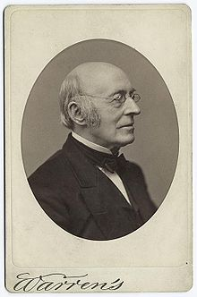

Slide 16
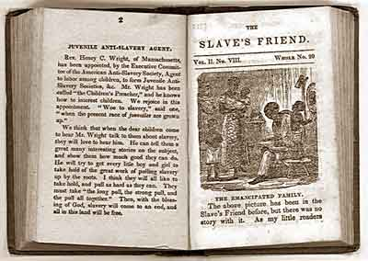
The Liberator would not have been successful had it not been for the free blacks who subscribed. Approximately seventy-five percent of the readers were free African-Americans.

Slide 17
“Where there is a human being, I see God-given rights inherent in that being, whatever may be the sex or complexion.”
“Resolved, That the compact which exists between the North and the South is a covenant with death and an agreement with hell; involving both parties in atrocious criminality, and should be immediately annulled

Slide 18
"I am in earnest — I will not equivocate — I will not excuse — I will not retreat a single inch — AND I WILL BE HEARD,”

Slide 19
Nat Turner’s Rebellion
• Nat Turner, preacher, leads slave rebellion; about 60 whites killed
• Turner, followers, innocent are captured; 200 killed in retaliation

Slide 20
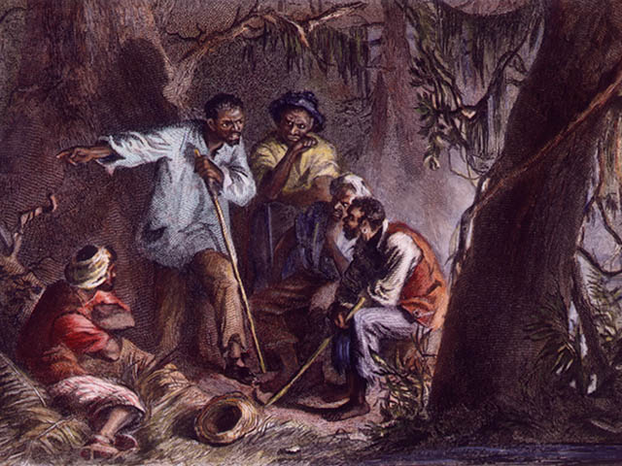

Slide 21
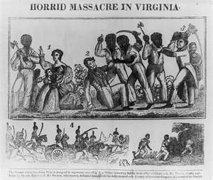

Slide 22
Backlash from Revolts
Southern states create slave codes to tighten limits on blacks
Free African Americans as well as slaves lose rights

Slide 23
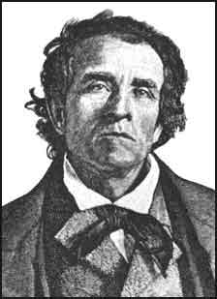
Theodore Dwight Weld
He reached the public through his publications at the time: The Bible Against Slavery (1837), and Slavery As It Is (1839).

Slide 24
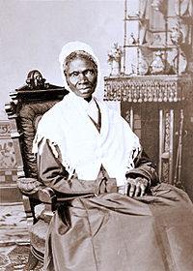
Sojourner Truth
Born into slavery
She traveled around the east and midwest preaching for human rights
Spoke forcefully for the abolition of slavery, women’s rights and suffrage, the rights of freedmen, temperance, prison reform and the termination of capital punishment.

Slide 25
"If the first woman God ever made was strong enough to turn the world upside down all alone, these women together ought to be able to turn it back, and get it right side up again."
– Sojourner Truth
"If women want any rights more than they's got, why don't they just take them, and not be talking about it?"
– Sojourner Truth

Slide 26
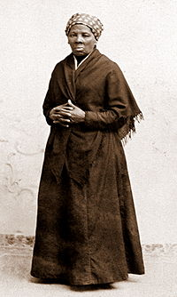
Harriet Tubman
Perhaps the most well-known of all the Underground Railroad's "conductors."
Ten-year span she made 19 trips into the South and escorted over 300 slaves to freedom.

Slide 27
Frederick Douglass
• As a slave, Frederick Douglass taught to read, write by owner’s wife
• Douglass escapes; asked to lecture for Anti-Slavery Society
• Douglass’s The North Star: abolition through political action

Slide 28
