Slide 1
A ROYAL PROCLAMATION
October 7, 1763
WHEREAS we have taken into Our Royal Consideration the extensive and valuable Acquisitions in America, secured to our Crown by the late Definitive Treaty of Peace, concluded at Paris the 10th Day of February last; and being desirous that all Our loving Subjects, as well of our Kingdom as of our Colonies in America, may avail themselves with all convenient Speed, of the great Benefits and Advantages which must accrue therefrom to their Commerce, Manufactures, and Navigation, We have thought fit, with the Advice of our Privy Council, to issue this our Royal Proclamation, hereby to publish and declare to all our loving Subjects, that we have, with the Advice of our Said Privy Council, granted our Letters Patent, under our Great Seal of Great Britain, to erect, within the Countries and Islands ceded and confirmed to Us by the said Treaty, Four distinct and separate Governments, styled and called by the names of Quebec, East Florida, West Florida and Grenada, and limited and bounded as follows, viz.

Slide 2
And Whereas, We are desirous, upon all occasions, to testify our Royal Sense and Approbation of the Conduct and bravery of the Officers and Soldiers of our Armies, and to reward the same, We do hereby command and impower our Governors of our said Three new Colonies, and all other our Governors of our several Provinces on the Continent of North America, to grant without Fee or Reward, to such reduced Officers as have served in North America during the late War, and to such Private Soldiers as have been or shall be disbanded in America, and are actually residing there, and shall personally apply for the same, the following Quantities of Lands, subject, at the Expiration of Ten Years, to the same Quit-Rents as other Lands are subject to in the Province within which they are granted, as also subject to the same Conditions of Cultivation and Improvement; viz.
To every Person having the Rank of a Field Officer—5,000 Acres.
To every Captain—3,000 Acres.
To every Subaltern or Staff Officer—2,000 Acres.
To every Non-Commission Officer—200 Acres.
To every Private Man—50 Acres.

Slide 3
And We do further declare it to be Our Royal Will and Pleasure, for the present as aforesaid, to reserve under our Sovereignty, Protection, and Dominion, for the use of the said Indians, all the Lands and Territories not included within the Limits of Our said Three new Governments, or within the Limits of the Territory granted to the Hudson's Bay Company, as also all the Lands and Territories lying to the Westward of the Sources of the Rivers which fall into the Sea from the West and North West as aforesaid.

Slide 4
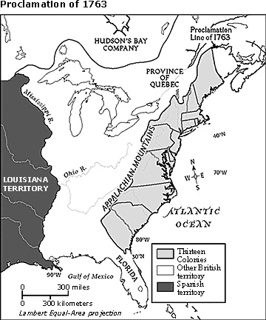

Slide 5
Purpose of the Proclamation of 1763
To organize Britain’s new North American empire and to stabilize relations with Native Americans.
Regulated colonial expansion and established governments for four areas: Quebec, West Florida, East Florida, and Greneda.

Slide 6
Created a boundary line between the colonies on the Atlantic Coast and American Indian lands west of the Appalachian Mountains.
British government was in charge of all land transactions in the new territories.
Colonists were upset because they felt they deserved the land beyond the Appalachian Mountains because they fought for it.

