Slide 1
Identify the following in your notebook.
Nationalism
Adams-Onis Treaty
Monroe Doctrine
Missouri Compromise
*Look at the map on page 223.
1.How did the Missouri Compromise promote sectionalism?

Slide 2
Nationalism Drives The Country

Slide 3
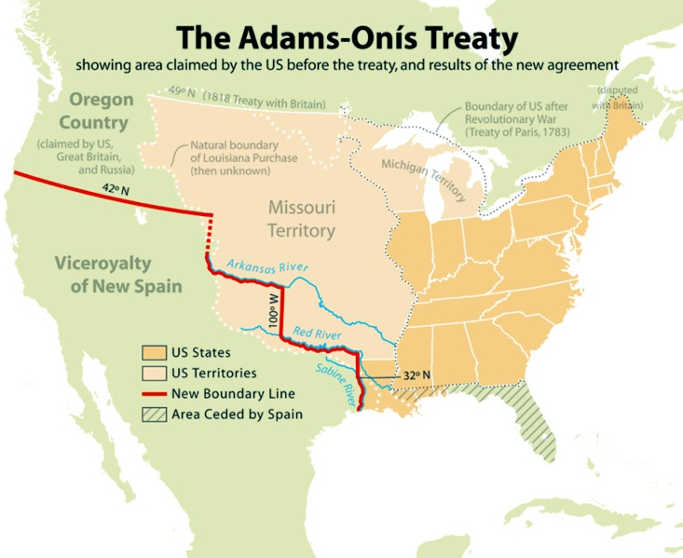
-Spain gives up Florida
-Too weak to police the territories.
-Spain also gives up claim to Oregon Territory

Slide 4
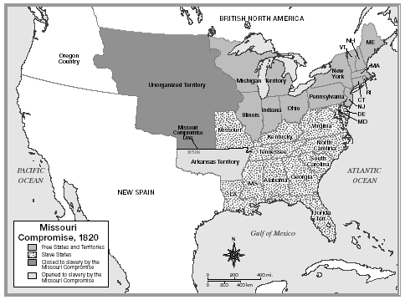
On March 6th, 1820 President James Monroe passed the Missouri Compromise, effectively allowing Missouri into the Union as a slave state, and admitting Maine as a free state.
36/30 Line

Slide 5
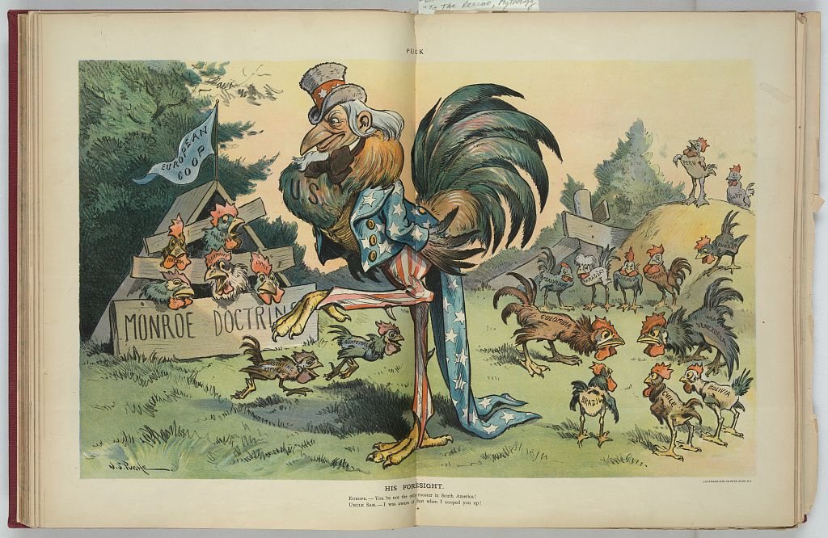

Slide 6
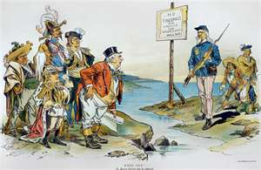
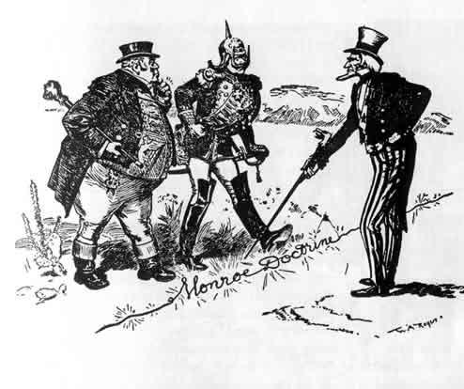
Monroe Doctrine- 1823 President Monroe warns Europe not to interfere in the Americas. In return America will not involve itself in European affairs.

