Slide 1
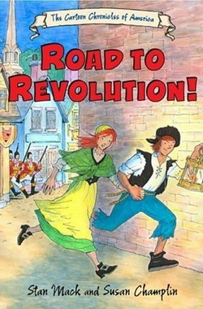

Slide 2
Mercantilism
- 17th and 18th centuries, England and many other European countries believed that power depended upon monetary wealth.

Slide 3
Principles of Mercantilism
the belief that the amount of wealth in the world was relatively static
the belief that a country's wealth could best be judged by the amount of precious metals or bullion it possessed
the need to encourage exports over imports as a means for obtaining a favorable balance of foreign trade that would yield such metals

Slide 4
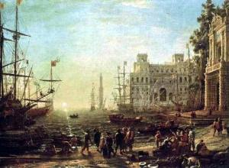

Slide 5
Viewed Colonies as Source of Wealth
Colony Responsibilities:
provided raw materials for the mother country
Imported manufactured products of higher values from England
Could not compete with the mother country in economic activities.

Slide 6
Navigation Acts (1651)
All commerce with the colonies had to be carried on English built/owned ships
Certain products (sugar, tobacco, cotton) can only be exported to England and its colonies
Imports from Europe to the colonies had to be brought first to English ports for payment for import duties before being sent to America

Slide 7
Some benefits to colonists
Growth of ship building in the New England colonies
Colonists had a monopoly on some products
Colonial trade received the protection of the English Navy

Slide 8
London Magazine 1766
“The American is apparelled from head to foot in our manufactures…. He scarcely drinks, sits, moves, labours or recreates himself, without contributing to the profit of the mother country”

Slide 9
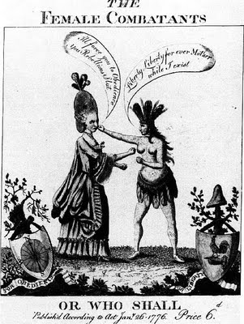
An English woman in an enormous beehive hairdo, against America, an Indian woman. The English woman says: "I'll force you to Obedience, you Rebellious Slut," to which America replies: "Liberty, Liberty forever, Mother, while I exist." The use of an Indian woman as a symbol of America was not invented by the rebellious English colonists; the symbol was used as early as 1581 in Philippe Galle's America. The revolutionary Americans did adapt the symbol as an icon of an emerging national identity.

