Slide 1
Manifest Destiny
Definition-
Belief that U.S. was destined to expand to the Pacific Ocean and into Mexican territory. Thought it was ordained by God.

Slide 6
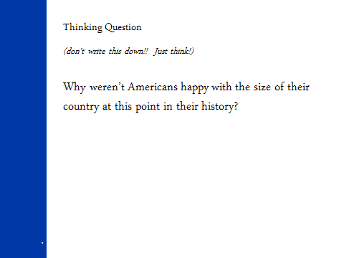

Slide 10
Why did they go?
As the population of the original 13 Colonies grew and the U.S. economy developed, the desire and attempts to expand into new land increased.
For many colonists, land represented potential income, wealth, self-sufficiency and freedom. Expansion into the western frontiers offered opportunities for self-advancement.
Increased opportunities for trade with Asia.

Slide 11
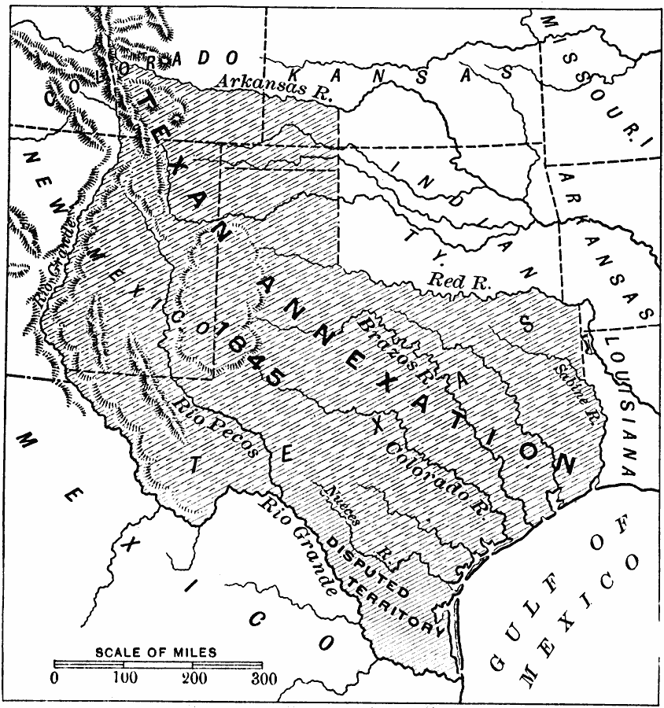
Journalist John L. O'Sullivan wrote an article in 1839 which predicted a "divine destiny" for the United States
Led to the
annexation or
the take over of
Texas from Mexico.

Slide 12
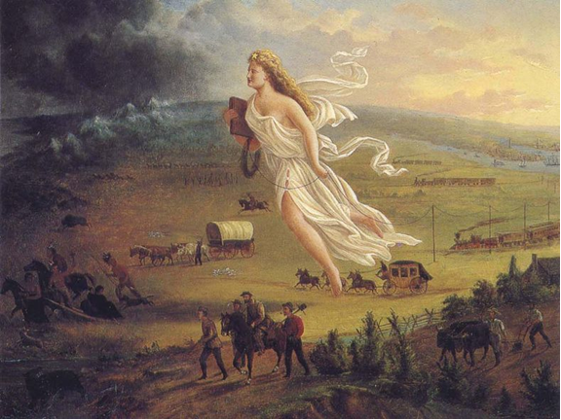
Spirit of the Frontier
In 1872 artist John Gast painted a popular scene of people moving west that captured the view of Americans at the time. Called "Spirit of the Frontier" and widely distributed as an engraving portrayed settlers moving west, guided and protected by a goddess-like figure and aided by technology (railways, telegraphs), driving Native Americans and bison into obscurity. It is also important to note that angel is bringing the "light" as witnessed on the eastern side of the painting as she travels towards the "darkened" west.

