Slide 1
American Revolution
Loyalists and Patriots

Slide 2
Essential Questions:
Who were loyalists and who were patriots?
What did loyalist and patriots believe?

Slide 3
Imagine yourself traveling back through time. It’s 1775. You arrive in a land called New England, a land where you hear talk of colonists and Kings. Your family immigrated here from England and your father is still loyal to the King. Your older brother calls himself a rebel and talks of independence and fighting for the cause. You’ve always looked up to your brother but you don’t want to disappoint your father.
“Loyalty or liberty?” they ask.
What will you decide?

Slide 4
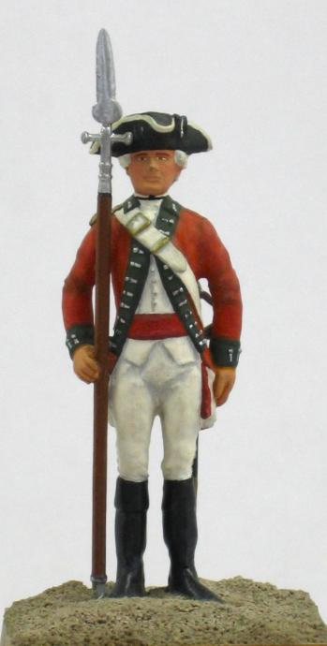
Loyalist –Those who opposed independence and remained loyal to the crown.
1. Judges, councilors, governors
2. People who lived far from city
3.Thought Britain would win the war.
4. Wanted to avoid being punished
5. Thought the crown would protect their rights more effectively.

Slide 5
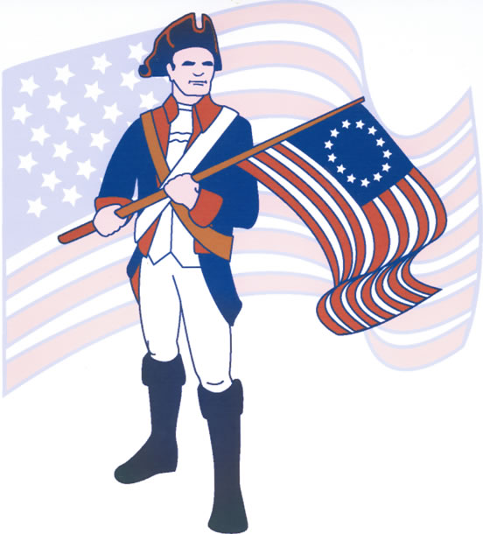
Patriot- those who wanted independence.
People who saw economic opportunity in an independent America.
Farmers, artisans, merchants, landowners, elected officials.
Highly educated, wealthy

Slide 7
Patriot vs. Loyalist Arguments
You will need to decide if the statement is a PATRIOT statement or a LOYALIST statement.
For each statement, record the underlined portion in your T-chart.

Slide 8
Patriots vs. Loyalists: Who said it?
King George III is doing the best he can with a difficult situation. He is not a cruel or unjust ruler.
No one should have to pay a tax unless they choose the representative who helps determine that tax.
England has refused us our God-given rights.
Since England does not have the right to tax us, then they also do not have the right to make other laws that affect us.
We should pay our fair share to England. We have wealth, religious freedom, and opportunity for all. We are far better off than other countries.
We need the protection that England can give us. They protected us in the French and Indian war. They can also protect us in future conflicts.
England and the colonies all have the same roots. A war against England is like having a war against our own family.
Morally, we are better than England. We know the difference between right and wrong. England's government is corrupt.

