Slide 1
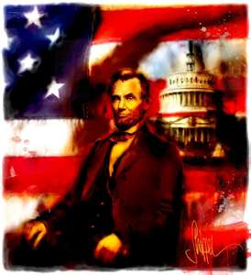
Lincoln’s Views on Slavery

Slide 2
Beginning of his presidency
Lincoln returned fugitive slaves to their owners
did not want war with the South over slavery
supported a plan of voluntary emigration of freed slaves to Panama or Liberia

Slide 3
- Lincoln did not believe in the equality of the races
- Largely inactive during the abolitionist movement
I am not now, nor ever have been in favor of bringing about in any way the social or political equality of the white and black races. I am not now nor ever have been in favor of making voters or jurors of Negroes, nor of qualifying them to hold office, nor of intermarriages with white people. There is a physical difference between the white and the black races which will forever forbid the two races living together on social or political equality. There must be a position of superior and inferior, and I am in favor of assigning the superior position to the white man.
Lincoln in his speech to Charleston, Illinois, 1858

Slide 4
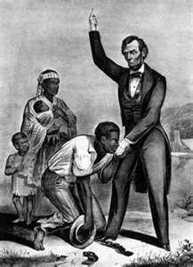
- The Emancipation Proclamation was partially a strategic political and military move but it also illustrated Lincoln’s changing views on the morality of slavery

Slide 5
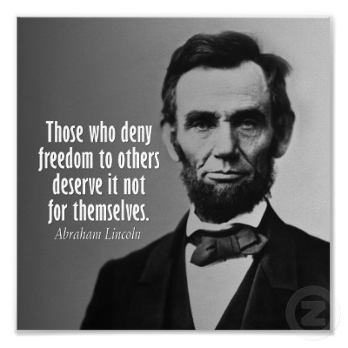
Lincoln let experience shape his views
Showed great personal growth during his presidency, especially regarding the topics of slavery and race.
“Whenever I hear anyone arguing for slavery, I feel a strong impulse to see it tried on him personally.”

Slide 6
http://lincoln.lib.niu.edu/aboutbiovideo.html

