Slide 2
On the right - Union:
kepi
Sack Coat
Pants
Brogans (shoes)
On the left - Confederate:
Slouch hat
Shell Jacket
Pants
Brogans (shoes)

Slide 3
1. Canteen
2. Pan
3. Cartridge box (Union)
4. Tooth brush
5. Razor
6. Soap
7. Blanket
8. Silver wear
9. Plate
10. Comb
11. Musket
12. Money (Confederate)
13. Photographs
14. Bible
15. Stamps (Confederate,
Jefferson Davis prints)
16.Haversack (Union)

Slide 5
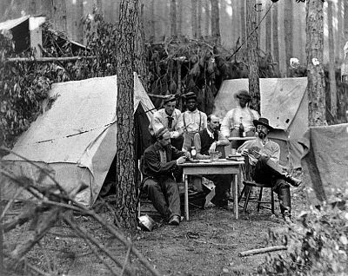

Slide 10
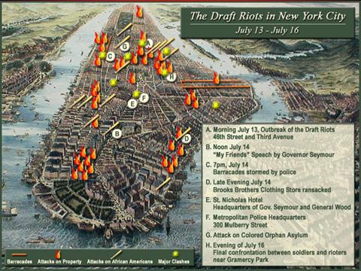
All male citizens between twenty and thirty-five and all unmarried men between thirty-five and forty-five years of age were subject to military duty. The federal government entered all eligible men into a lottery. Those who could afford to hire a substitute or pay the government three hundred dollars might avoid enlistment. Blacks, who were not considered citizens, were exempt from the draft.

