Slide 1
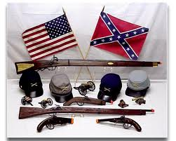
The Legacy of the Civil War

Slide 2
Political Changes
War ended further threats of succession.
Before: Federal Gov. had little impact on most people’s daily lives
During: Taxed private incomes, required everyone to accept new paper currency
After: People assumed the government was always within reach of them

Slide 3
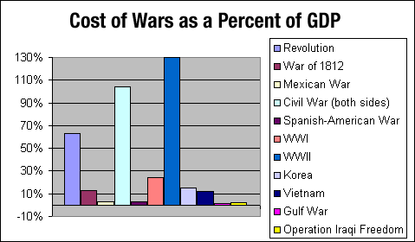
Economic Changes
1863- National Bank Act (set up federally charted banks, inspections, safe banking for investors.
North economy boomed
South Devastated-
took away cheap labor,
lost 40%of livestock,
destroyed machinery
and railroads.
Est. Cost- $3.3. billion

Slide 4
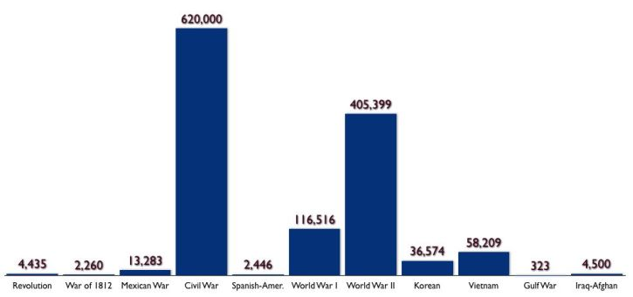
Soldiers and Civilians
Union- 360,000 soldiers died
Confederate – 260,000 died
Soldiers- 2,400,000 men 10% of nations population
Disrupted education, careers, and families

Slide 5
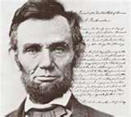
African-Americans
New birth of freedom
13th Amendment was passed
"Neither slavery nor involuntary servitude, except as a punishment for crime whereof the party shall have been duly convicted, shall exist within the United States, or any place subject to their jurisdiction." Formally abolishing slavery in the United States, the 13th Amendment was passed by the Congress on January 31, 1865, and ratified by the states on December 6, 1865.

