Slide 1
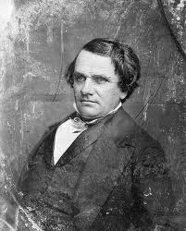
Tension in Kansas and Nebraska
Popular Sovereignty
Stephen Douglas believes people want territories incorporated into Union
Feels popular sovereignty on slavery best way to organize new states
Notes:
Wants railroad west in Chicago; thinks expansion will help Democrats
Thinks slavery unworkable in prairie farms but seeks South’s support

Slide 2
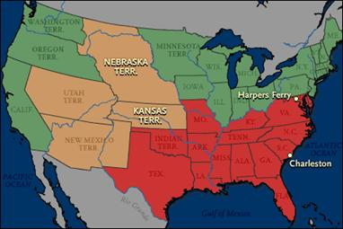
The Kansas-Nebraska Act
Douglas’s bill repeals Missouri Compromise; bitter debate ensues
1854 Kansas-Nebraska Act allows popular sovereignty on slavery

Slide 3
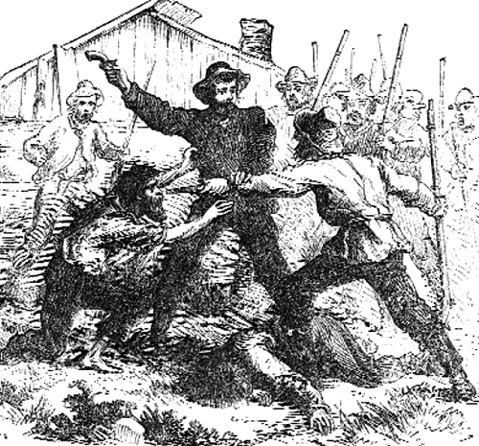
Violence Erupts in “Bleeding Kansas”
The Race for Kansas
Northern, Southern settlers pour into Kansas Territory
Most settlers sent by antislavery emigrant aid societies
In 1855, Kansas holds election for territorial legislature
Proslavery “border ruffians” vote illegally, win fraudulent majority
Proslavery government in Lecompton; antislavery rival in Topeka

Slide 4
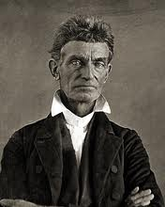
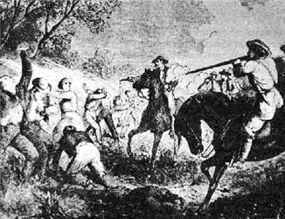
“The Pottawatomie Massacre”
Abolitionist John Brown believes God wants him to fight slavery
Brown, followers violently kill 5 men in “Pottawatomie Massacre”
Territory called Bleeding Kansas for incidents that kill some 200

Slide 5
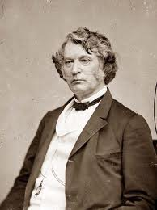
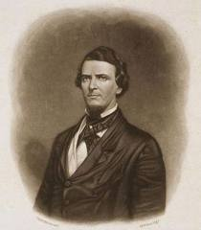
Violence in the Senate
Senator Charles Sumner verbally attacks colleagues, slavery
Congressman Preston S. Brooks beats Sumner for insults to uncle
Southerners applaud Brooks; Northerners condemn him

Slide 6
