Slide 1
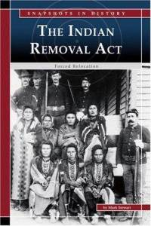
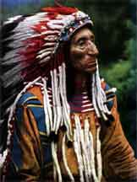

Slide 2
Two ideas among Whites about how to deal with the Indian “problem”
Civilization – they would ultimately become Americanized
Removal – based on idea that civilization was not going to succeed and the only thing to do was to find some place in the West to settle Native Americans.

Slide 3
- By 1810 many Native Americans began to migrate west voluntarily, but most refused.
- Jackson believed the only solution was to move the Native Americans off their land.
Thinks assimilation cannot work
Too many troops needed to keep whites out of native lands
- Congress passes Indian Removal Act of 1830 and forces Native Americans west

Slide 4
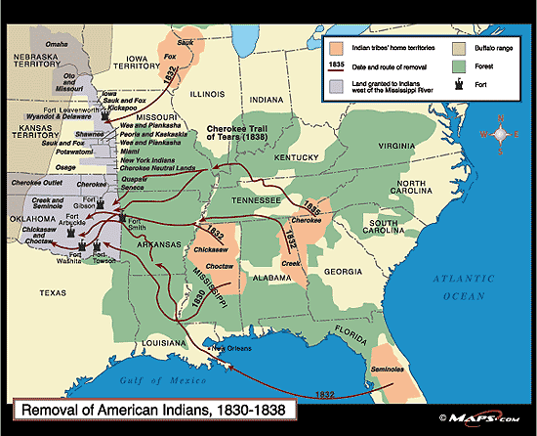

Slide 5
