Slide 1
Define:
Wilmot Proviso
Secession
Compromise of 1850
Popular Sovereignty
Page 308.
Copy middle section of the Compromise of 1850 into notebook.

Slide 2
Protest, Resistance, and Violence
Proslavery and antislavery factions disagree over the treatment of fugitive slaves and the spread of slavery to the territories.

Slide 3
Wilmot Proviso
California, Utah and New Mexico Territories would be closed to slavery forever.
Divided Congress-
Northerners supported proviso
Southerners opposed proviso

Slide 4
Fugitive Slaves
The Fugitive Slave Act
Fugitive Slave Act—part of Compromise of 1850, has very harsh terms
Alleged fugitives denied jury trial, right to testify on own behalf
Federal commissioners paid more for returning than freeing accused
People convicted of helping a fugitive fined, imprisoned, or both

Slide 5
Resisting the Law
• Northerners send fugitives to Canada, some use force in rescues
• Personal liberty laws forbid prison for fugitives, grant jury trials

Slide 6
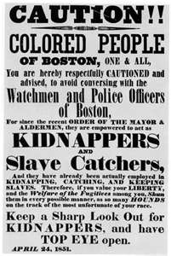

Slide 7
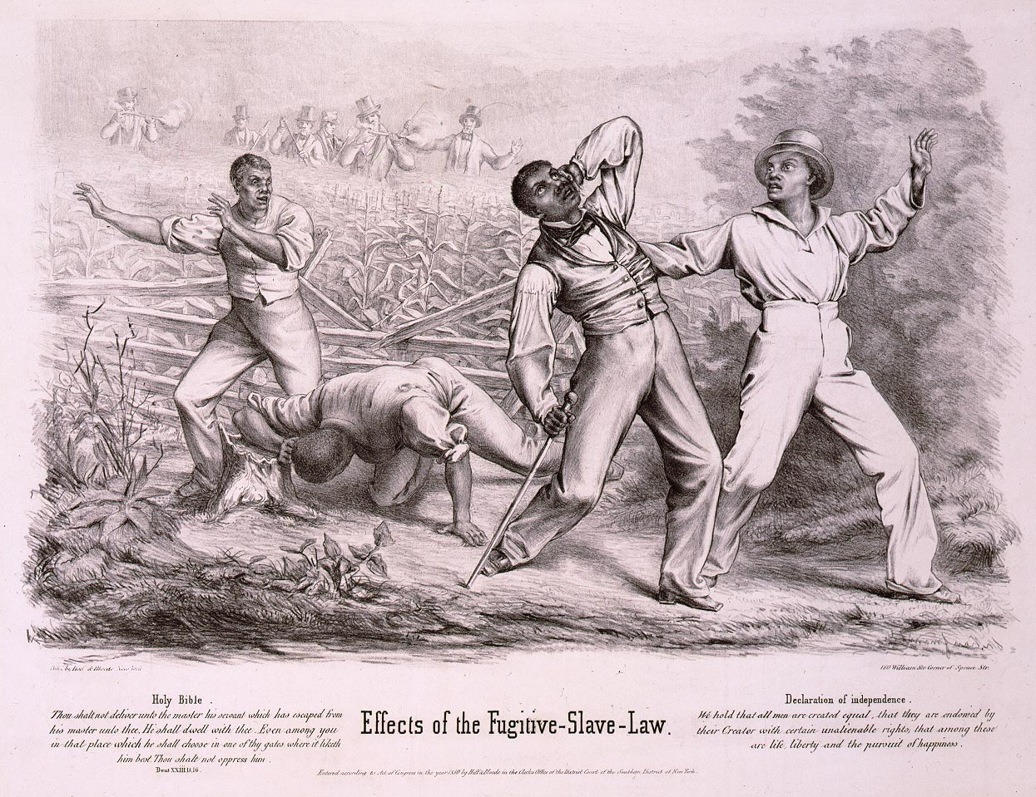

Slide 8
