Slide 1
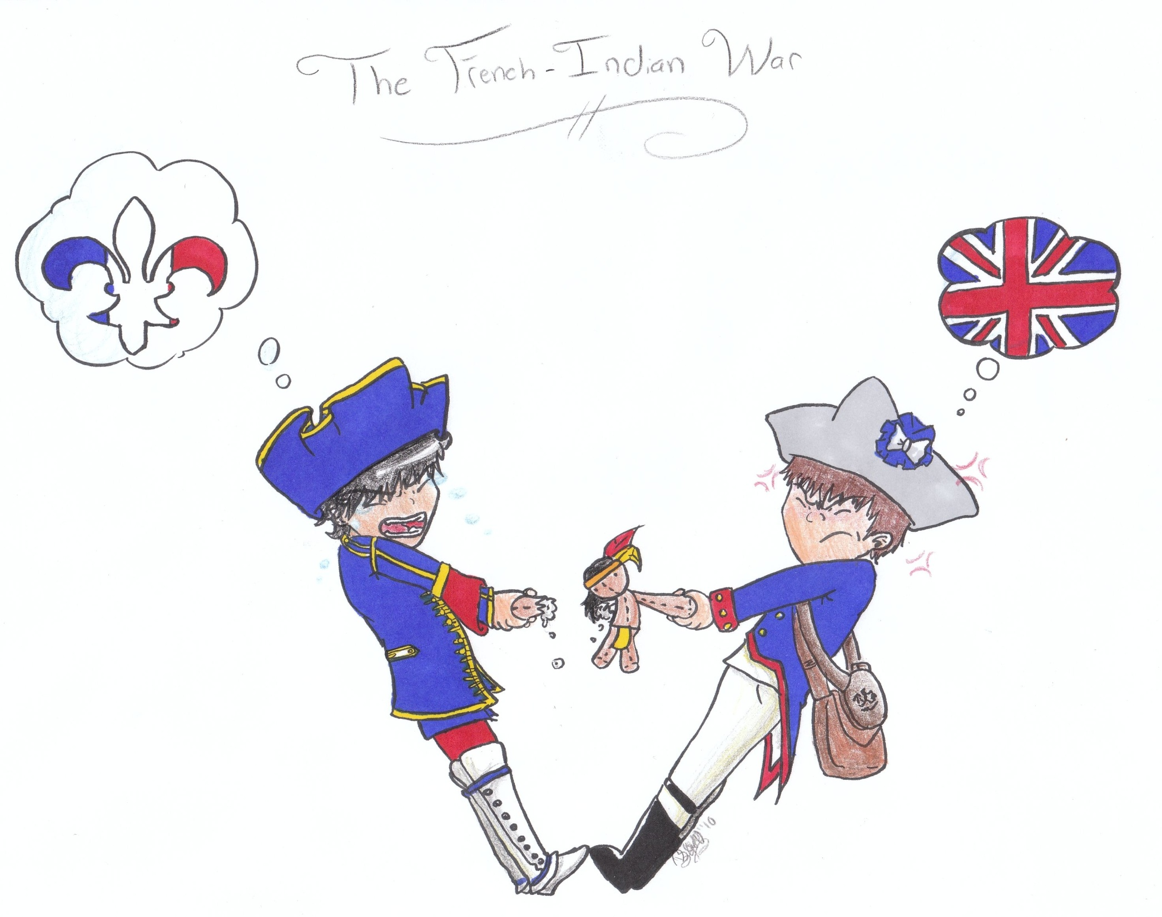

Slide 2
Causes Of
France’s empire began to collide with the British.
1754 - Dispute over land in the Ohio River Valley.
George Washington is sent to evict the French

Slide 3
French build Fort Duquesne
British build Fort Necessity (40 miles from the French)
May 1754- Washington was attacked and in July was forced to surrender.
Battle marked the beginning of the French and Indian War.

Slide 4
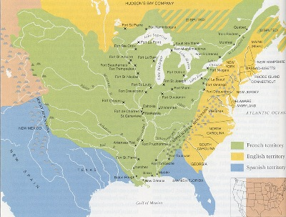

Slide 5
Albany Plan of Union 1754
As the French and Indian War was near there became an urgency for cooperation among the colonies.
Plan was to place the colonies under a more centralized government.
Drafted by Ben Franklin.
Plan failed but would serve as a possible model for future attempts at a union.

Slide 6
It is proposed that humble application be made for an act of Parliament of Great Britain, by virtue of which one general government may be formed in America, including all the said colonies, within and under which government each colony may retain its present constitution, except in the particulars wherein a change may be directed by the said act, as hereafter follows.
That the said general government be administered by a President-General, to be appointed and supported by the crown; and a Grand Council, to be chosen by the representatives of the people of the several Colonies met in their respective assemblies.

Slide 7
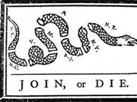

Slide 8
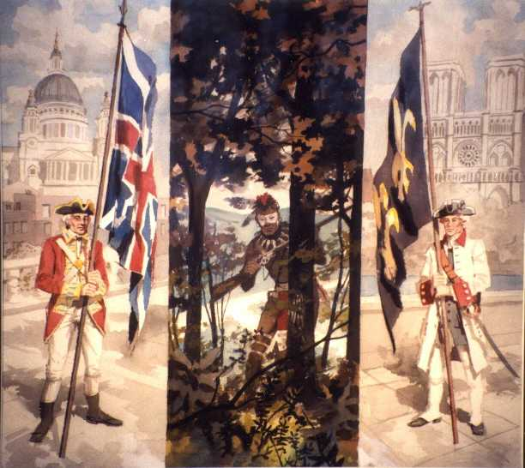
The French and Indian War

Slide 9
The French and Indian War
Most Native American Indians fought on the side of the French
Although few did fight on the side of the English
The English sent General Edward Braddock commander in chief of the British forces to America to drive the French out of the Ohio Valley

Slide 10
July 9, 1755: Native American Warriors and French troops ambushed Braddock and his men
The French and Native Americans hid behind trees and fired at the bright uniforms of the British
The British confused and frightened could not even see their attackers
The British lost badly loosing nearly 1,000 soldiers including their Commander in Chief General Edward Braddock --> created a rift between British army and colonial leaders.

Slide 11
British Lose to French and Indians During March to Duquesne

Slide 12
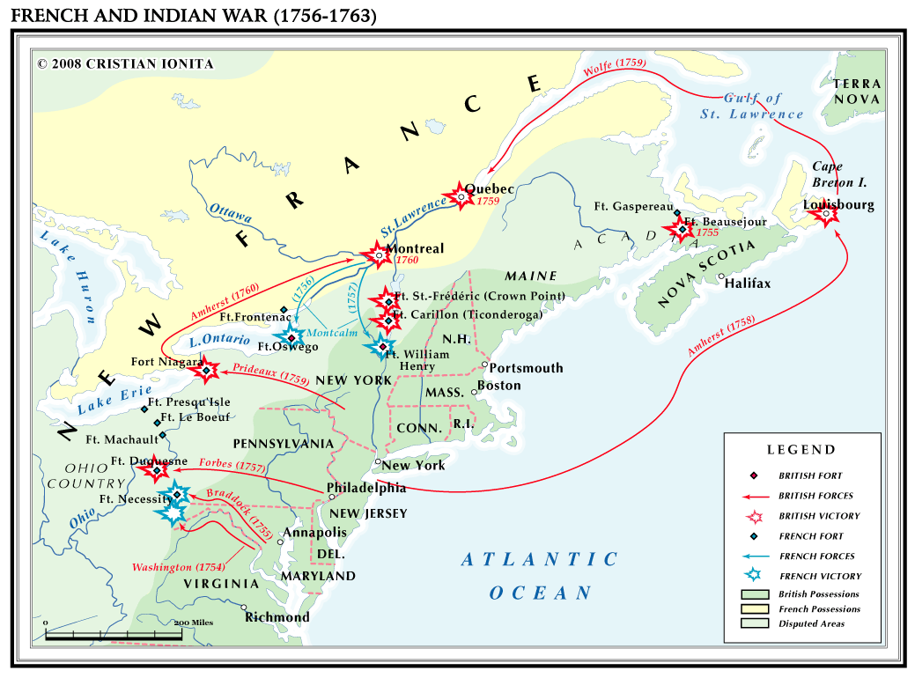
After the victories by
the French, William
Pitt is selected as
leader and gains the
support of the Iroquois.
Sept 1759- James
Wolfe and Jeffery
Amherst catch the
French off guard in
Quebec and lead
Britain to victory.

Slide 13
The Treaty of Paris in 1763 officially ends the war.
Terms of agreement:
Great Britain- receives all of North America east of the Mississippi River
Spain – gains all French land west of the Mississippi River, including New Orleans
France – gain Canada, islands near New Foundland and the West Indies
Native Americans – Found it harder to bargain with the British

Slide 14
