Slide 1
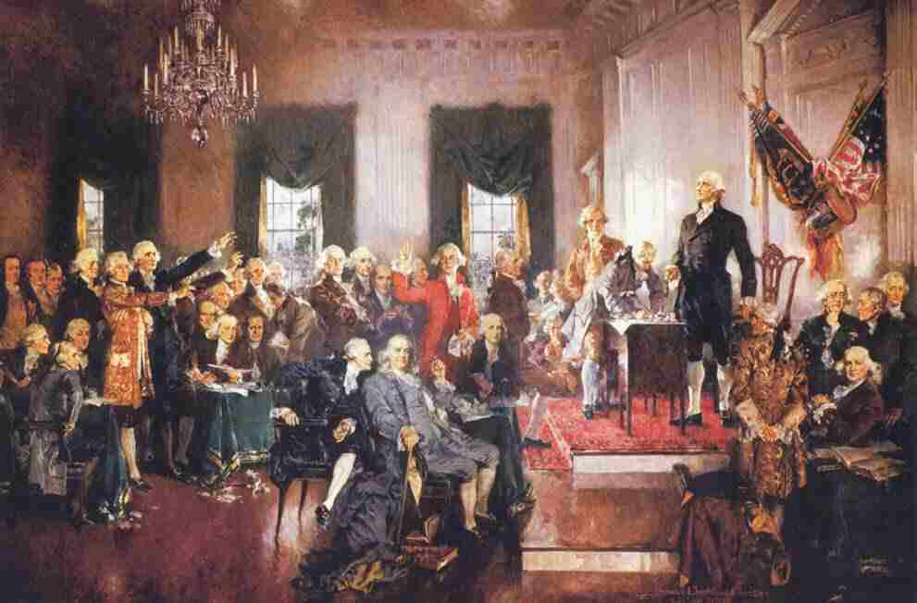
Forming A New Government

Slide 2
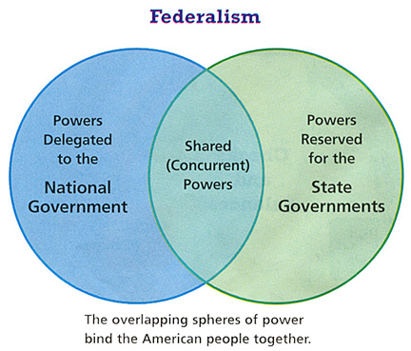

Slide 3
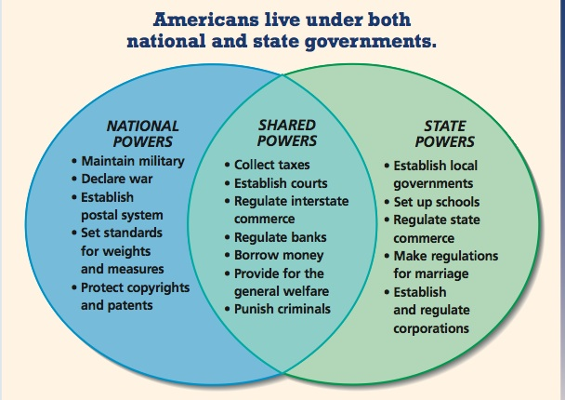

Slide 4
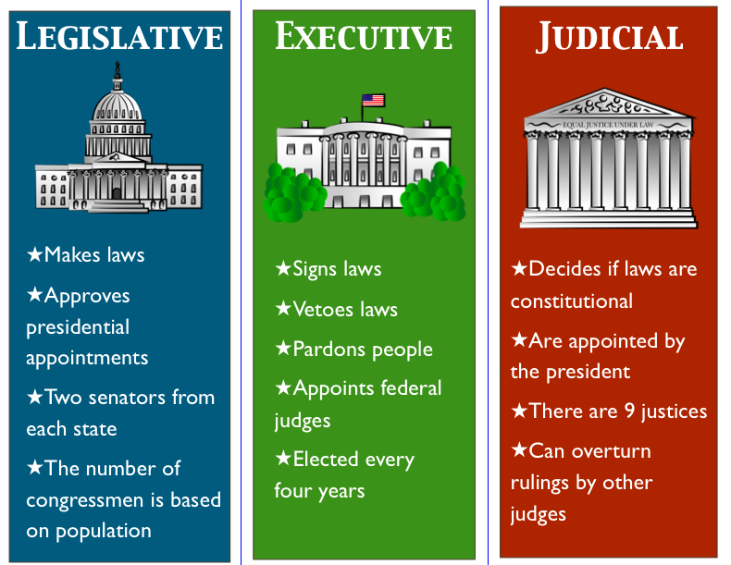

Slide 5
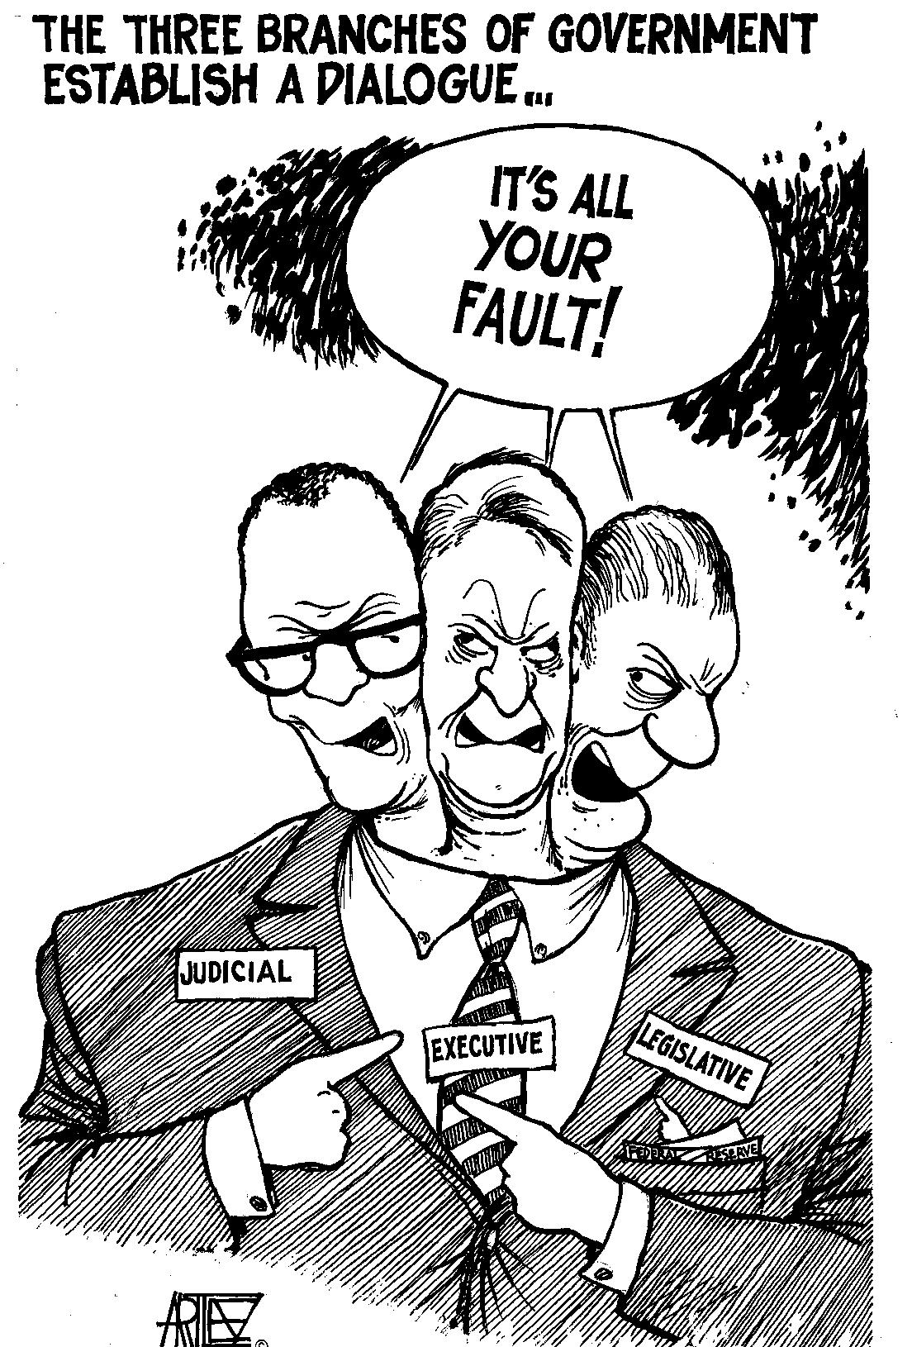
Checks
And
Balances

Slide 6
Two concerns in electing a president:
No national parties
No trust in the common people to make decisions.
Electoral College was developed to elect a president.
-Each state chooses a number of electors equal to the number of senators and representatives the state has in Congress.

Slide 8
Homework Assignment
Write a position paper on whether or not you agree with the use of the electoral college to elect a president.
Agree- Why do you think it works?
Disagree- What would you change, add, or what else should be used? Why do you think it is unfair?
Be sure to provide examples to support your stance.
Response should be at least 3 paragraphs long.

