Slide 1
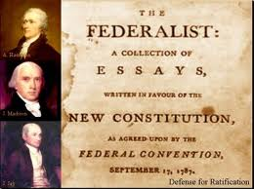
Federalist Papers

Slide 2
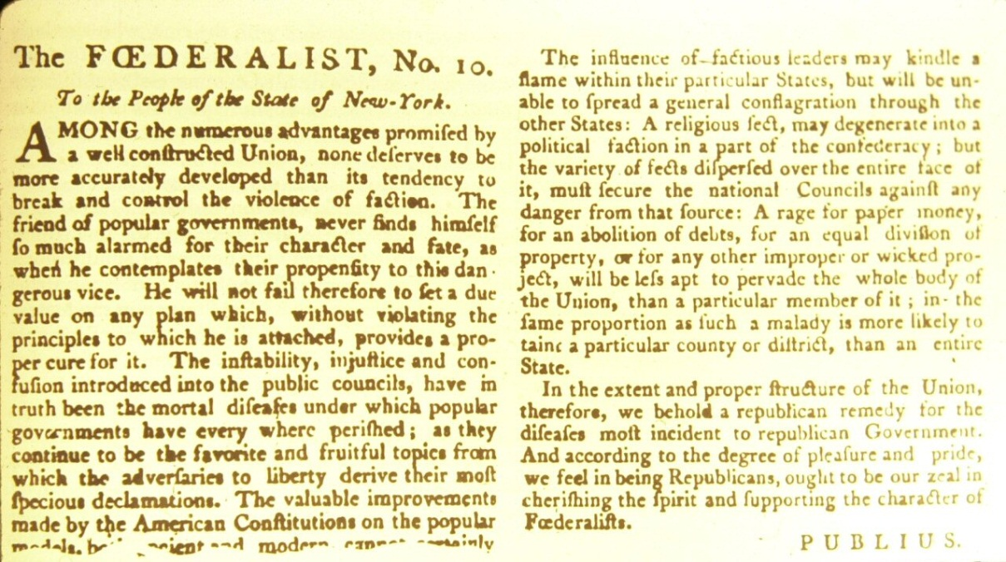
Federalist Papers appeared in N.Y. newspapers between 1787-1788.
There were a series of 85 essays defending the new constitution.

Slide 3
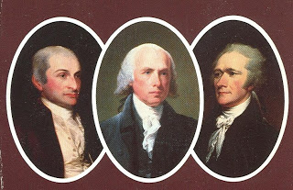
Written by Federalist leaders:
- Alexander Hamilton (52 papers)
- James Madison (28 papers)
- John Jay (5 papers)
Papers were published under the false name Publius.

Slide 4
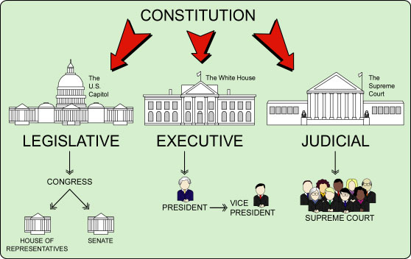
Papers provided an analysis and an explanation of Constitutional powers.
Example: separation of powers and the limits on the power of majorities.

Slide 5
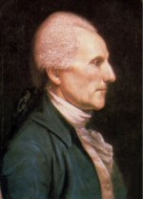
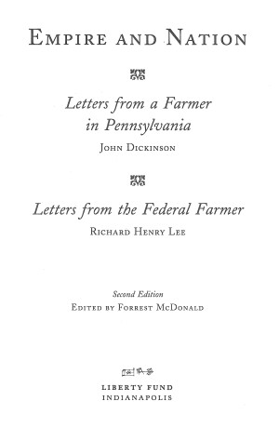
Antifederalists publication was called Letters from the Federal Farmer.
Written by Richard Henry Lee
Listed the rights the Antifederalists believed should be protected.
Example: Freedom of the press and religion, right to trial by jury.

