Slide 1
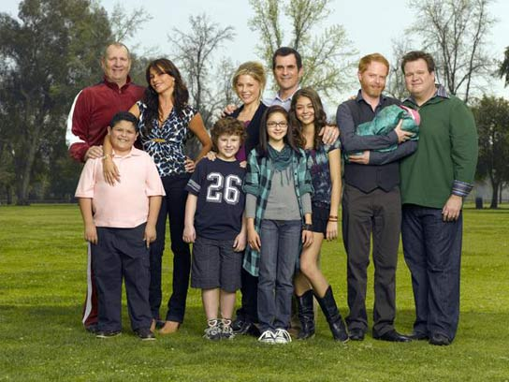
What are some types of families?
Do Now
•Think about your family. If there was a theme song that illustrates your family, what would it be?

Slide 2
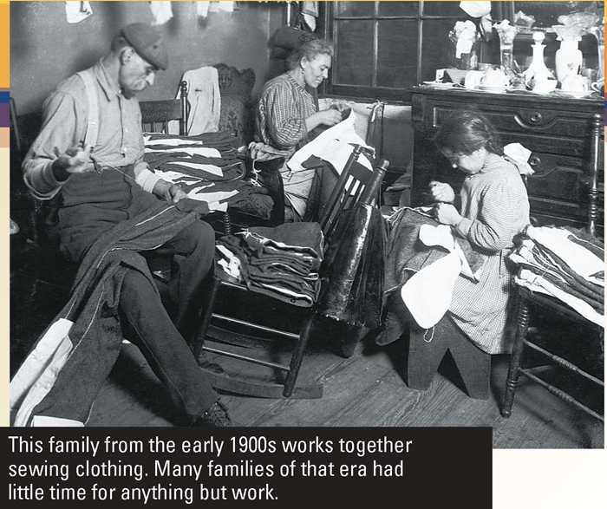

How have family dynamics changed?

Slide 3
Families and Households: Definitions
Family, household kin, extended, nuclear, reconstituted, household, non-traditional family.

Slide 4
Family and Kin
Family = group of people living together related by blood or marriage who support themselves economically/emotionally.
Kin = wider collection of related people beyond the immediate family.

Slide 5
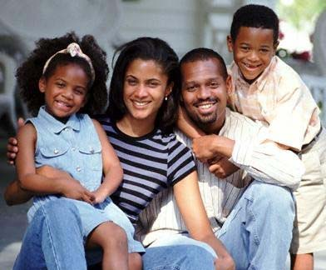

Types of Families: Nuclear
Nuclear family – is made up of no more than two generations (parents and children).

Slide 6

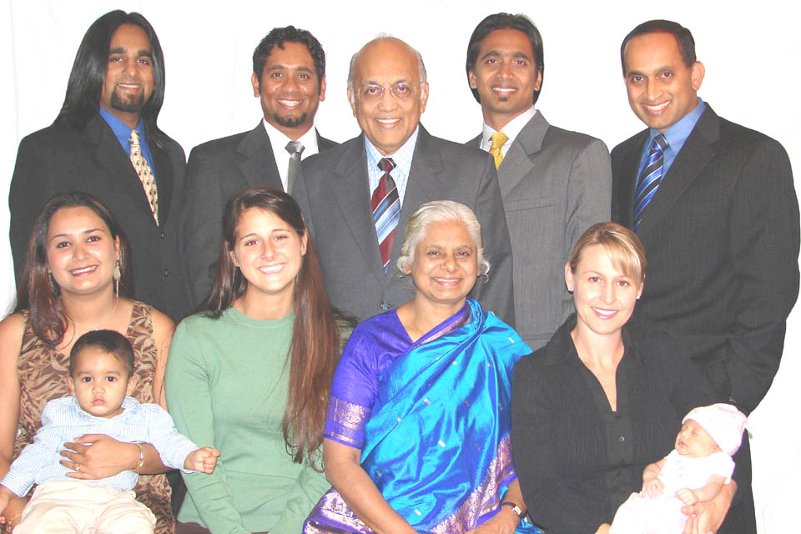
Extended Family
Extended Family – is made up of large number of people usually three generations or more who live together or by each other – type typical of pre industrial societies.

Slide 7
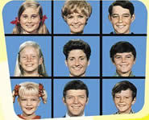
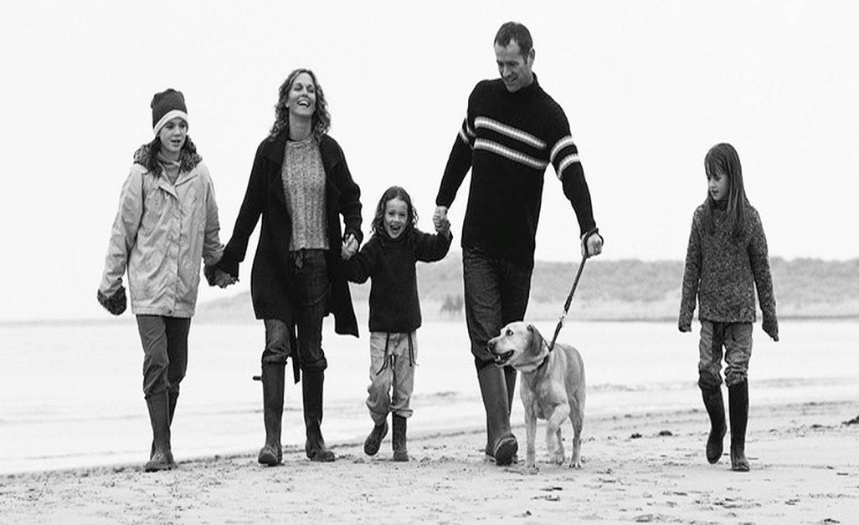
Resconstituted Family
The Reconstituted (Blended) Family – is formed by adults who have married previously and who bring children from their previous marriage to the new marriage, forming a new family unit.

Slide 8
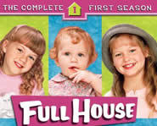
Household & Nontraditional Familes
The Household – a household is a group of people who live in the same accommodation. While most families live in households, not all households correspond to a family unit.
Some households could be considered families because they support each other emotionally and financially

Slide 9
Activity: TV Shows and Commercials
Think about and write down five (5) current tv shows about families and try to put into a category.
Five (5) old TV shows and do the same
Do the same for five (5) TV commercials? Is there a difference?
Identify similarities and differences between them and present back to the class.

Slide 10
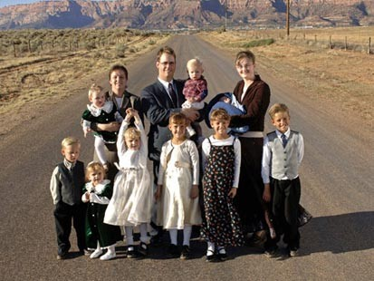
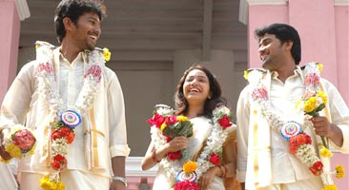
Types of Polygamous Families
Polygamy - the marriage of one man to a number of wives.
Polyandry – the marriage of one woman with a number of husbands.

Slide 11
Nuclear | Extended | Blended | Household | Polygamous | Alternative

Slide 12

What did we learn?
Which type of family is most represented in current day TV shows?
Which type of family is most represented in old TV shows?
Which kinds of families are represented in commercials?
Is there a difference between the types in TV shows vs. commercials? If so, why?

Slide 13
What did we learn?
Family
group of people living together related by blood or marriage who support themselves economically/emotionally
Kin
wider collection of related people beyond the immediate family.

Slide 14
What did we learn?
Nuclear Family
is made up of no more than two generations (parents and children).
Extended Family
is made up of large number of people usually three generations or more who live together or by each other – type typical of pre industrial societies.
Reconstituted Families
formed by adults who have married previously and who bring children from their previous marriage to the new marriage, forming a new family unit.
Household
group of people who live in the same accommodation. While most families live in households, not all households correspond to a family unit

Slide 15
Reading:
Do Now
Full House: Four Parents and two kids make for one big happy family

Slide 16
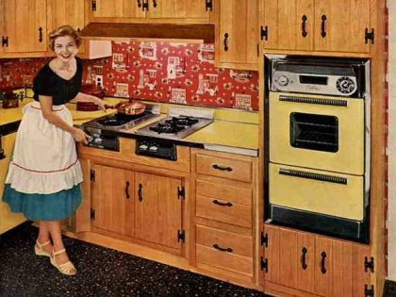
A Sociological Look at Marriage.
Do now
Reading: “The Good Wife” © 1955

Slide 17
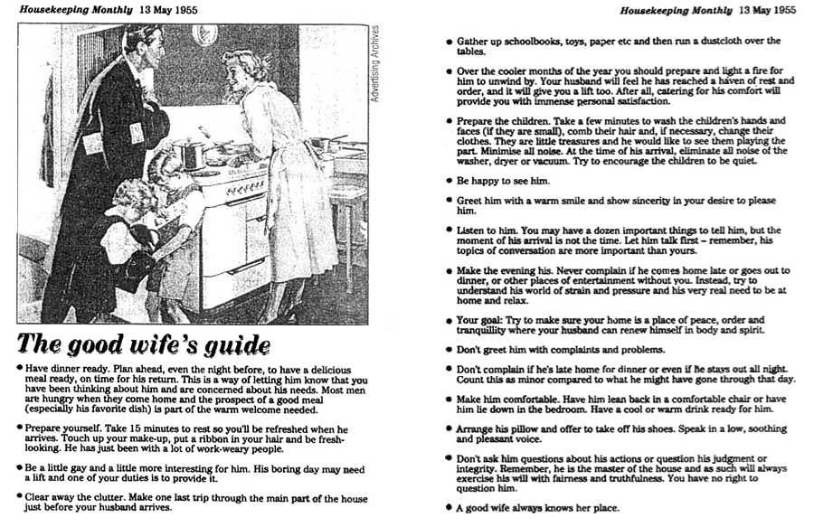

Slide 18
Rank your top 10 characteristics for a marriage partner…
Honest and truthful
Fun to be with
Same educational background
Will take care of me
Wants to have children
Communicates well with me
Will share household jobs and tasks
Is a good friend with whom I can talk
Is of the same religious background
Makes decisions
Earns good money
Is physically attractive
13. Is in love with me and I with him/her
Encourages me to be my own person
Has interests like mine in money and having fun
Makes me feel important
Is faithful
Shares mutual interests in home, children, romantic love, and religion.
Has had a happy childhood with happily married parents
Is emotionally mature
Is prepared to support a family
Is interested in waiting to marry until age 22 or older
Wants a six-month to two-year engagement period

Slide 19


Do you think marriage is necessary?
Do you see yourself as ever getting married?

Slide 20
Marriage
Marriage – religious or cultural ceremony which marks a couple as married.
Monogamy – marriage of one man and one woman.
Types and Longitudinal Studies of American Marriage. (Handout)

Slide 21
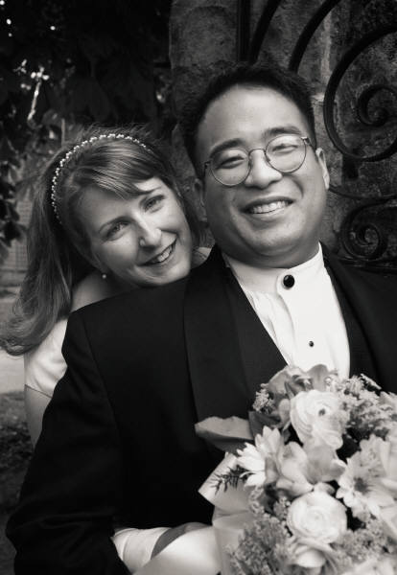
Do Now:
Did your “marriage” work?
What were some main obstacles?
What were some issues you found you could resolve.

Slide 22


Marriage Activity
Girls: Pick a number out of box 1
Boys: Pick a number out of box 2
Find your matching number-partner. Find a seat with two desks together.
Take a role out of the box
Congratulations! You have fallen in love at first sight. You just ran off and got married…now the fun begins

Slide 23
What kind of wedding did you have?
What will your family think?
Where will you live?
Where will you work. Will both work?
Who pays for what?
How many kids will you have?
Daycare? Nanny? Loss of an income?
Who will care for the kids?
How will you raise your children? (schools, religious beliefs, discipline?)
How will you handle children from previous relationships?
How will you deal with Thanksgiving, Christmas, Hanukkah, birthdays?
How will you incorporate former relationships, spouses, children from other marriages into your lives?

Slide 24
Do Now:
Sociological Theories on the role of family by Theory:
If you could describe your family in one word…what would it be?

Slide 25
Theories of the family: Functionalism
Some sociologists suggest the family is the best organizational basis for society.
4 functions of the family: sexual, reproductive, economic and educative (socialization).
Primary socialization – the teaching of societies shared norms and values, and the stabilization of adult personalities – the family provides an arena for adults to let off steam then return calmly to the outside world.
What did you learn from your family BEFORE Kindergarten so you would fit in?

Slide 26
Theories of the Family: Marxism
Frederick Engels claimed the family only came into existence with the invention of private property.
Without the family there could be no effective system of private property because parentage and inheritance would be impossible to determine.
The family is seen as a means of social control and reproduces capitalist society.
The family is an exploitative institution.
In modern day – what happens to families financially when there is a divorce?

Slide 27
Theories of the Family: Feminism
There are 3 main strand of feminist thought: liberal, radical and Marxist
All emphasize the central importance of patriarchy (male domination of society) to understanding the family.
Liberal feminists assert the family serves the needs of men, reinforces patriarchy and oppresses women.
Radical feminists identify gender exploitation as the most fundamental form of domination. The family is seen as an economic system run for the benefit of all men.
Marxist Feminists empathise the “double exploitation” of women by capitalism and men. Men take the frustrations born of alienated labor under capitalism out within the family sometimes in the form of physical violence.
Can you give current day examples of any of these theories in the real world?

Slide 28
Theories of the Family: Interactionist
Interactionists take more account of the meanings people attach to the “family” and the actions and interactions which take place within real families
Who listens to who? Who makes the decisions? Who grounds you? What reasons would Mom ground you? Dad? Who decides vacations, spending?

Slide 29
Theories of the Family: Radical psychiatry
Roland Laing takes an interactionist approach and offers insight into the darker side of family life.
Families are seen as the principle cause of mental illnesses like borderline personality disorder, depression, and other mental illnesses throughout life through negative labeling and scapegoating within the family.
Are families the major cause of our psychological and emotional problems?

Slide 30
What have we learned?
What is the historical role of marriage?
What did Marx have to say about marriage?
What are some changes in marriage over the past 60 years?
What are some Theories of families and their impact on us?

Slide 31
Final Sociology Project
Choose one of the below Sociology Projects and complete by January 18th 2012:
Sociological Analysis of Age and Stage of Life:
Interview three people of different ages. They can be family members if you wish. Ideally you would have someone in young adulthood, (maybe a college student or someone just moving out on their own), an adult with children ages 25 through 50, and an older person like a Grandparent over 60 years of age.
You should prepare and ask them questions about
What their goals were when they were younger, and did they reach them?
How did their goals change as they aged?
Were there any life events that caused them to change their life goals?
What are their current life goals for the future?
What surprised them the most about life so far?
What do they feel the “best” age is, and why?
Sociological Analysis of Children’s Literature: Then & Now
Visit a local book store and look at the children’s book section. Find book from when you were a child and look at them. You could bring a parent and they could do the same from their childhood if they like. Now find the most current children’s books and make a comparison on how children, children’s interests and lifestyles and the world itself has changed based on the type of books written for children today. Explain what your favorite books were and why and how they are the same or different than what is out there today.
We currently live in a politically correct age. Design and complete the world’s most tolerant inclusive children’s book that includes as many groups, subgroups, cultures, sub cultures, counter cultures, and family patterns as possible.
Sociology and Society: Design a High School that will provide students with what they need for the future.
Design a school and a school program that would be ideal for an adolescent of the 21st century. You can draw/design the school, create a new curriculum, schedule, types of programs, period schedules, and anything else that you believe would do the following things:
Prepare the current adolescent generation for their specific future in society
Be realistic of the inequity of human beings in reference to economics, emotional and physical and social differences among adolescents. Remember….the goal is to create a high school that will create an environment where adolescents will not only flourish, but be prepared to take care of themselves in the future.
Be sure to explain why you made the decisions you did. You can create this as a packet with drawings or create a PowerPoint that will also explain your decisions. (You may need to hand this one prior to January 18th in order to present it.

