Slide 1
New Inventions
Inventor-entrepreneurs develop new products
Charles Goodyear creates vulcanized rubber in 1839
Factory production of clothing now possible; prices drop by over 75%

Slide 2
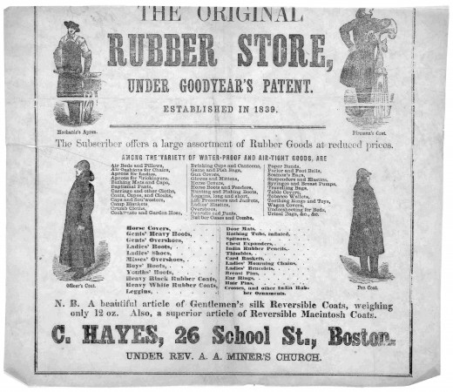

Slide 3
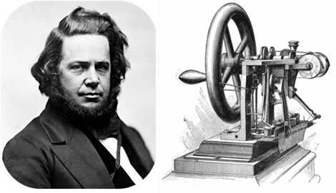
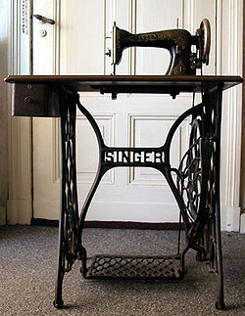
Elias Howe patents sewing machine
I.M. Singer adds foot
treadle

Slide 4
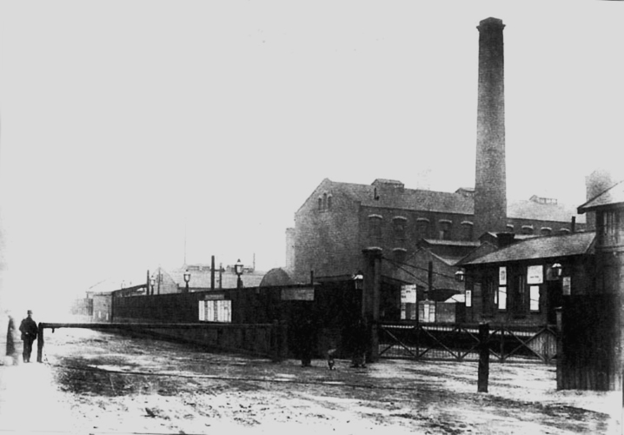
Factory production of clothing now possible; prices drop by over 75%

Slide 5
Technology lowers cost of factory items; workers become consumers
1837, Samuel F. B. Morse develops electromagnetic telegraph:
- messages tapped in code, carried by copper wire
- businesses, railroads transmit information

Slide 6
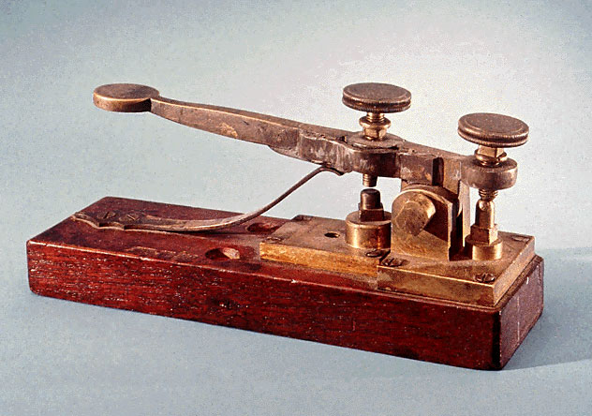

Slide 7
Emergence of Railroads
1840s, shipping by railroad much costlier than by canal
Railroads faster, operate in winter, go inland
Early train travel uncomfortable for passengers
By 1850s, railroads expand, cost drops, safety increased

Slide 8
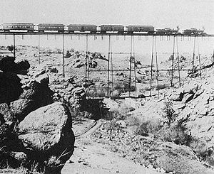

Slide 9
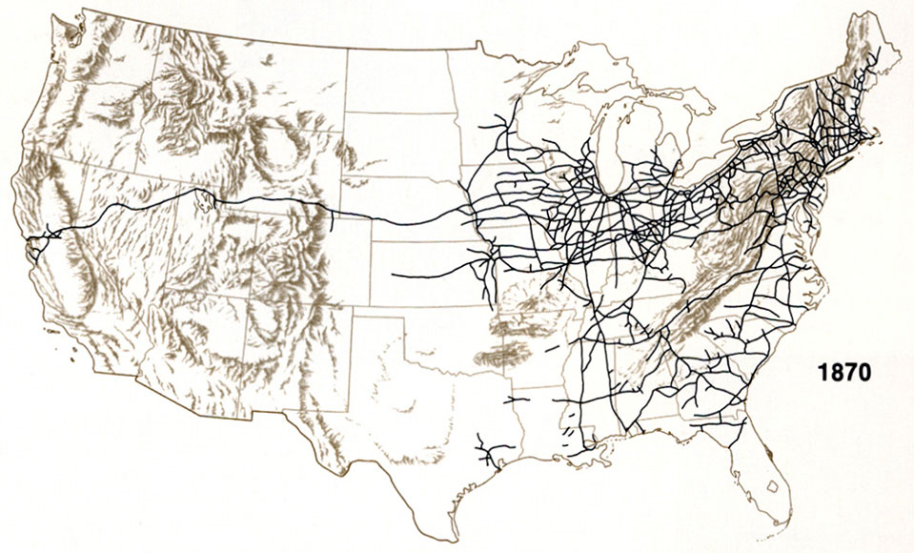

Slide 10
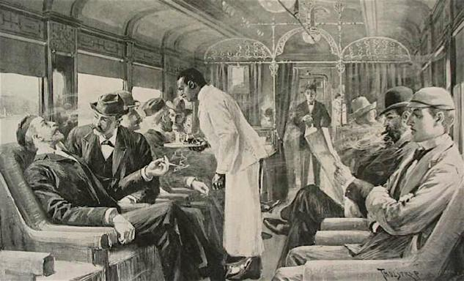

Slide 11
Poem Activity
With your partner read your selected poem and describe how the author is portraying the train.
*You may need a dictionary to look up words that are not familiar to you.

Slide 12
Invention Advertisement Poster Assignment
Choose an 1800s invention from your book (pages276-279)
Create a business advertisement poster for the invention.
Include the proper year for the invention.
Include what the purpose and benefit of your product is.

