Slide 1
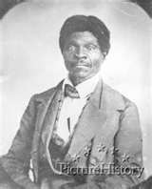
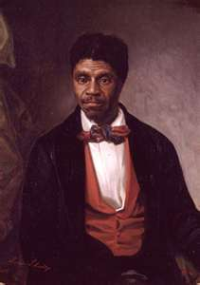
Dred Scott
Supreme Court Case
1857

Slide 2
“ Can a negro, whose ancestors were imported into this country, and sold as slaves, become a member of the political community formed and brought into existence by the Constitution of the United States, and as such become entitled to all the rights, privileges, and immunities guaranteed by that instrument to the citizens.”
A famous quote stated by
Chief Justice Roger B. Taney

Slide 5
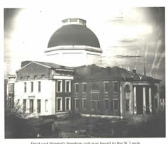
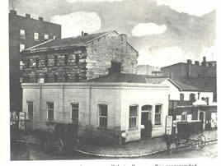
The St. Louis Circuit Court where
the case was held
The jail where Dred stayed in after and the first case.

Slide 6
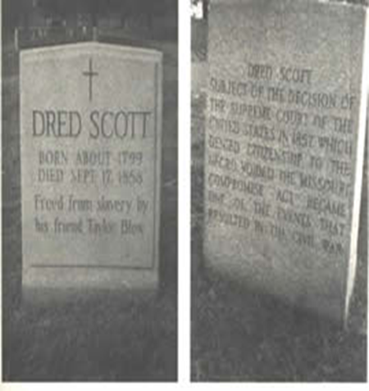
Dred Scott's tombstone in St. Louis.

Slide 7
