Slide 1
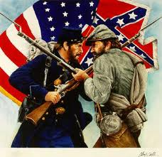
Civil War Leaders

Slide 2
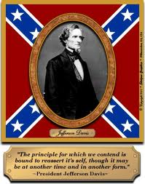
Jefferson Davis
President of the Confederacy
-President of the Confederate States of America. He was also Commander - in - Chief of the Confederate Army.
-Colonel in the United States Army during the Mexican-American War.
-Secretary of War and also a United States Senator.
-Born in the South and grew up on a cotton plantation.
-16 years old he went to the Military Academy at West Point.
-The training he got at the military school helped him to become a great military leader and is one of the reasons the Confederates won so many battles at the beginning of the Civil War.

Slide 3
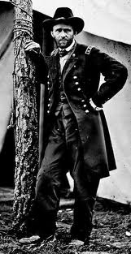
Ulysses S. Grant- Union General
-Leader of the Union Army.
-He had all the qualities President Lincoln wanted for the commander of his army.
-Grant fought very hard and was very stubborn in battles. He did not like to be defeated.
-Trained at the Military Academy at West Point, New York.
-Mexican-American War he was a second lieutenant in the army.
-When the Civil War began and the North began losing so many battles, Grant joined the Army for a second time.
-Excellent military leader because of his training and skill.
-General Robert E. Lee, the leader of the Confederate Army had to surrender to General Grant in 1865.
-Later General Grant became president of the United States twice. People remember him as a great war hero.

Slide 4
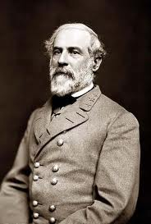
Robert E. Lee- Confederate General
-South's greatest general during the Civil War.
-Graduated from West Point Military Academy and became a colonel in the army before the Civil War began.
-From Virginia and decided to fight on the side of the Confederates even though President Lincoln asked him to be commander of the entire Union Army.
-Wanted to fight for the South and remain loyal to his home state.
-Fierce fighter and helped his soldiers win many battles at the beginning of the Civil War. But the Union Army was bigger and stronger.
-Lee felt he had to surrender to the North to stop so many of his soldiers from being killed.

Slide 6
