Slide 1
Boston Tea Party
The makings of a Revolution

Slide 2
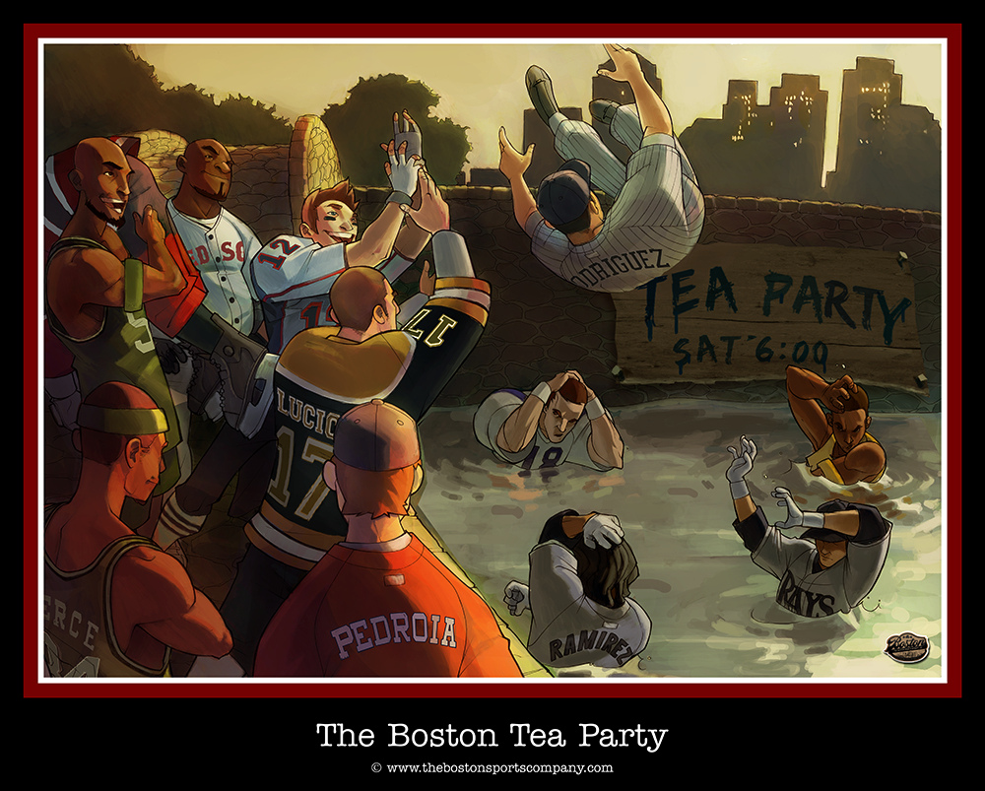

Slide 3
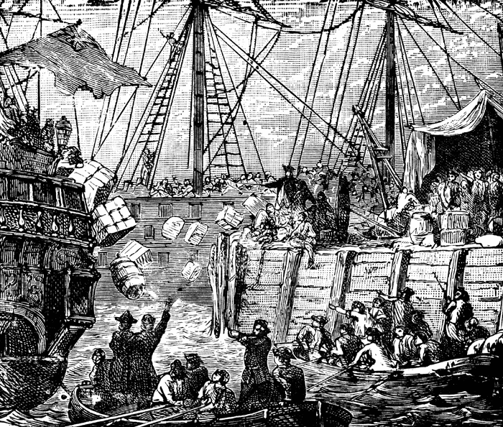

Slide 4
On Monday morning, the 29th of November, 1773, a handbill was posted all over Boston, containing the following words: "Friends! Brethren! Countrymen!--That worst of plagues, the detested tea, shipped for this port by the East India Company, is now arrived in the harbor.

Slide 5
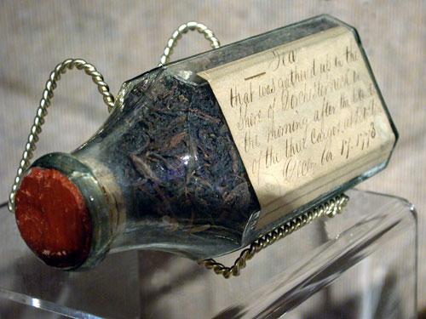
Tea, retrieved from Boston Harbor, which was thrown into the water during the Boston Tea Party.

Slide 6
The Boston Tea Party
In 1773 the British told the British East India Company it could send tea to America without paying the taxes. All other tea traders still had to pay a tax. The Americans refused to buy any tea and refused to unload the tea from the British ships in the American ports.
About 50 men from the Sons of Liberty dressed as Mohawk Indians. They boarded a tea ship in the Boston Harbor. These men then threw 342 chests tea valued at $75,000 into the water. One of these men was Paul Revere. Many people say this was the most important event that led to the start of the war between the colonies and the British.
http://www.youtube.com/watch?v=1aA7CWjz8vE&feature=related

Slide 7
