Slide 1
BOSTON MASSACRE
A CAUSE OF THE REVOLUTION
BUT SHOULD IT HAVE BEEN??
http://www.youtube.com/watch?v=YcDoN-KEiKQ
http://www.youtube.com/watch?v=Iyrv5emDC1Y&feature=related

Slide 2
Your dilemma…
You are an apprentice in Paul Revere’s shop in
March of 1770.
He has given you an assignment that has an
URGENT deadline. He has created an engraving
of a situation that occurred just days earlier in the
streets of Boston. He needs YOU to write the
article that will appear with the engraving in the
Boston Gazette. He has no time to explain ANY
facts. Write your article based only on what you
see in his picture.

Slide 3
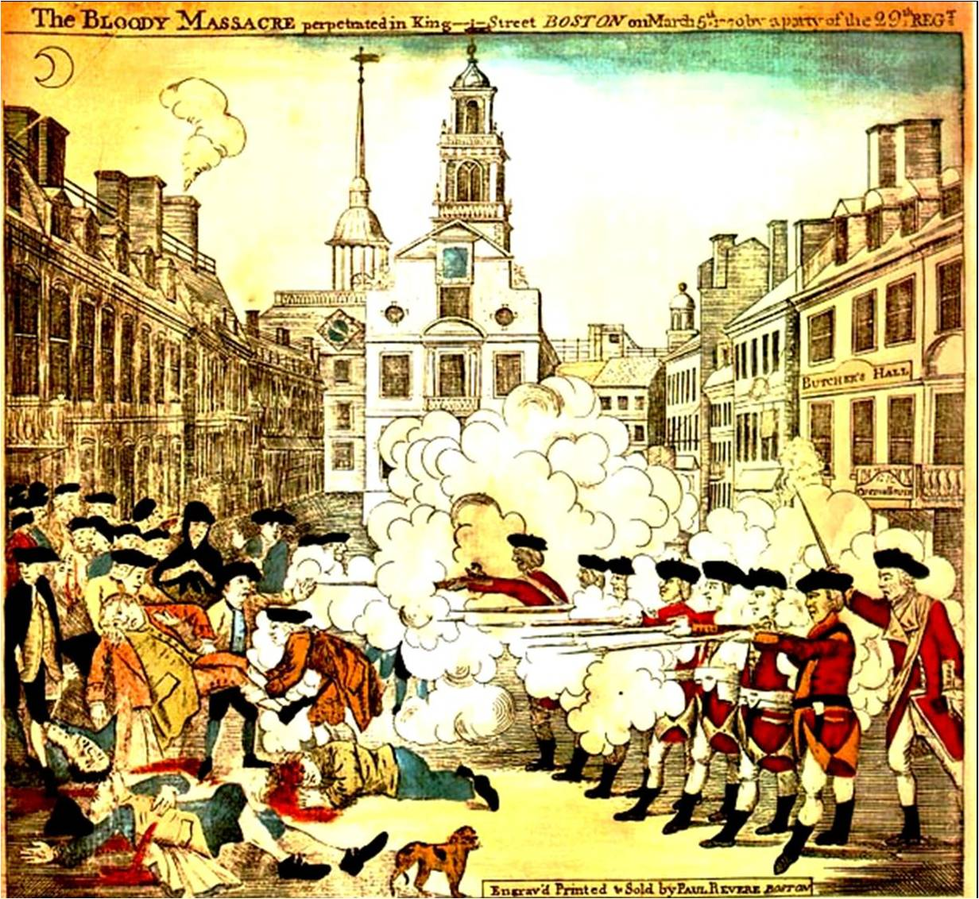
Things to consider:
Revere’s headline:
Bloody Massacre
perpetrated in King Street
Questions to ponder:
• Time of day
• Weather conditions
• What might have
happened immediately
before “captured” picture
• What were immediate
results of the incident
• Who is to blame
March 5, 1770

Slide 4
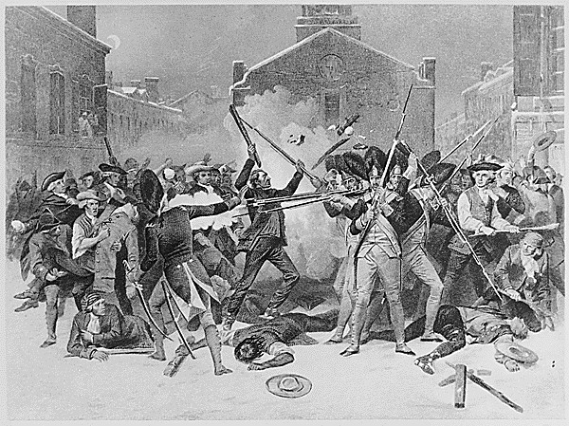

Slide 5
March 5, 1773: Diary entry of John Adams concerning his involvement in the trials
(The third anniversary of the Boston Massacre)
• "I devoted to I. . .myself endless labour and Anxiety if not to infamy and death, and
that for nothing, except, what indeed was and ought to be all in all, sense of duty.
In the Evening I expressed to Mrs. Adams all my Apprehensions: That excellent
Lady, who has always encouraged me, burst into a flood of Tears, but said she was
very sensible of all the Danger to her and to our Children as well as to me, but she
thought I had done as I ought, she was very willing to share in all that was to come
and place her trust in Providence.
• "Before or after the Tryal, Preston sent me ten Guineas and at the Tryal of the
Soldiers afterwards Eight Guineas more, which were. . .all the pecuniary Reward I
ever had for fourteen or fifteen days labour, in the most exhausting and fatiguing
Causes I ever tried: for hazarding a Popularity very general and very hardly earned:
and for incurring a Clamour and popular Suspicions and prejudices, which are not
yet worn out and never will be forgotten as long as History of this Period is read...It
was immediately bruited abroad that I had engaged for Preston and the Soldiers,
and occasioned a great clamour....
• "The Part I took in Defence of Cptn. Preston and the Soldiers, procured me Anxiety,
and Obloquy enough. It was, however, one of the most gallant, generous, manly
and disinterested Actions of my whole Life, and one of the best Pieces of Service I
ever rendered my Country. Judgment of Death against those Soldiers would have
been as foul a Stain upon this Country as the Executions of the Quakers or
Witches, anciently. As the Evidence was, the Verdict of the Jury was exactly right.
• "This however is no Reason why the Town should not call the Action of that Night a
Massacre, nor is it any Argument in favour of the Governor or Minister, who
caused them to be sent here. But it is the strongest Proofs of the Danger of
Standing Armies."

Slide 6
Important Things to remember:
Tensions between colonists and the British began to rise over jobs.
Crispus Attucks became the first casualty of the Revolutionary War.
John Adams had to defend the British soldiers in court.
British soldiers were found “not guilty”

Slide 7
Laptop Project
Go to the web address below to perform research on the Boston Massacre.
Go to the pictures tab and view the various pictures that have been produced for the massacre.
Choose one that you feel best represents the massacre.
Write your article based on your picture.
http://www.bostonmassacre.net
Email: arels@sps.springfield.ma.us

Slide 8
1) Look at the following pictures.
2) Choose one that you feel accurately represents what happened.
3) Write your Newspaper article.
http://ed101.bu.edu/StudentDoc/Archives/ED101sp07/srabino/Boston%20Massacre.gif
http://historyofmassachusetts.org/wp-content/uploads/2011/12/boston_massacre_Paul_Revere_illustration.gif
http://teach.beaverton.k12.or.us/~David_Leahy/FOV1-000828FB/0203/revolution/boston_massacre1.jpg
http://docsouth.unc.edu/neh/nell/nellfp.jpg

