Slide 1
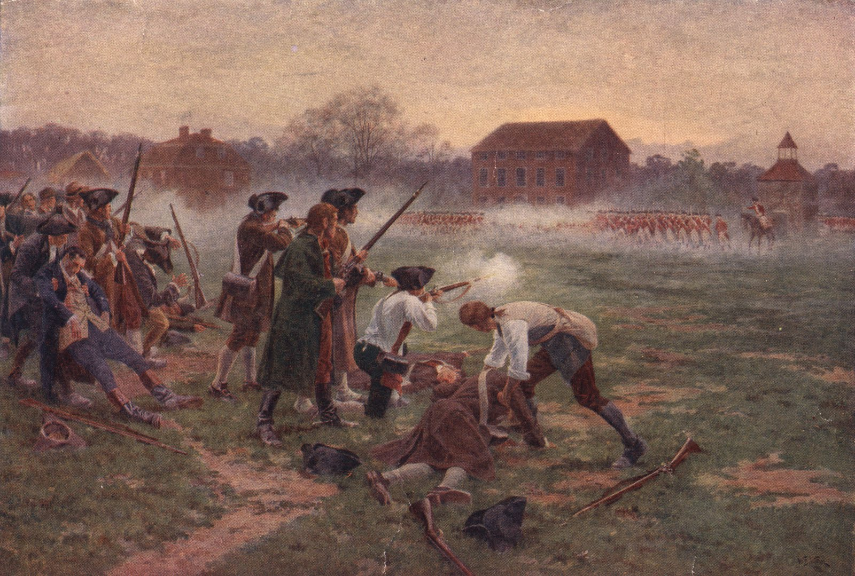
Battle of Lexington & Concord

Slide 2
1775- Civilian militia or minutemen begin to stockpile firearms.
British General Gage waits until the snow melts to march his troops along the Lexington road to Concord to destroy the munitions.
Paul Revere is sent to warn the townspeople of the British Attack.

Slide 3
British reach Lexington, ordered the minutemen to leave, colonists begin to leave but shots were fired by the British.
Troops march on to Concord, found nobody, began to march back to Boston, were ambushed by 3000-400 minutemen who fired on the marching troops.

Slide 4
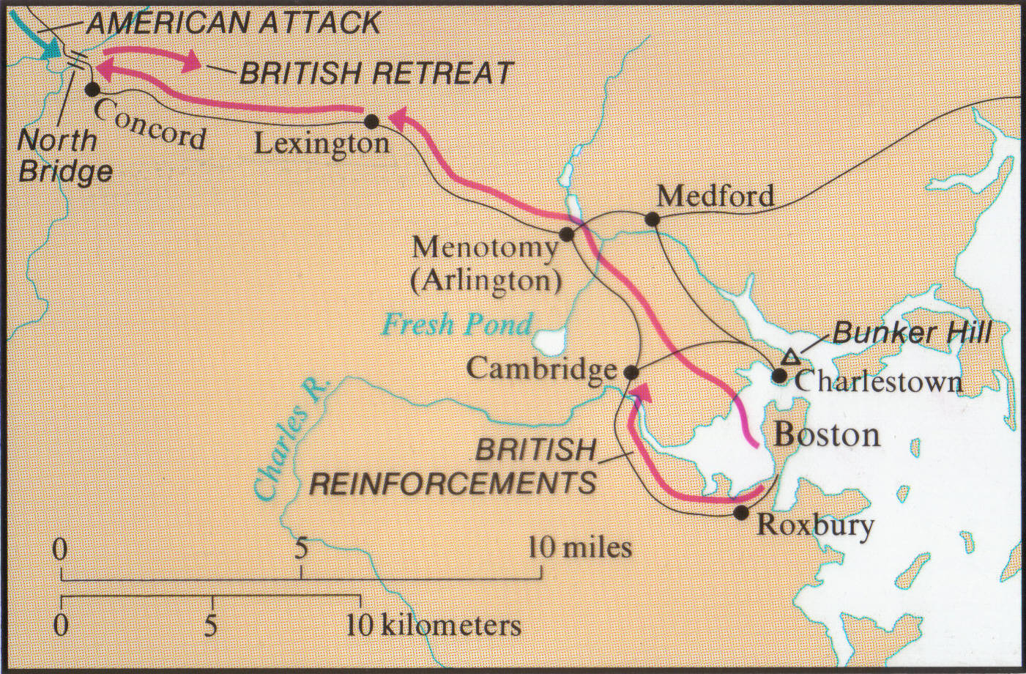

Slide 5
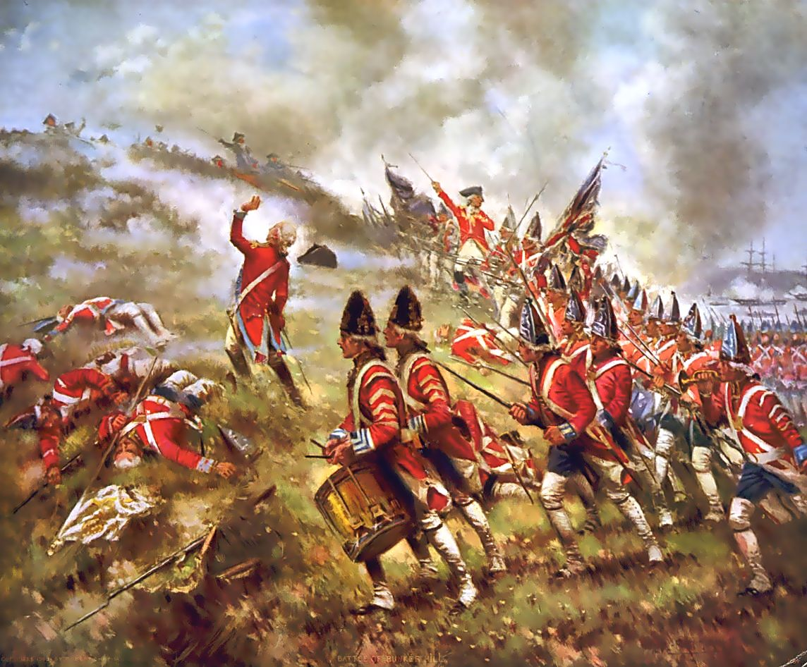
Battle at Bunker Hill

Slide 6
General Gage decides to strike on the militiamen on Breed’s Hill
British attack the hill 3 times before they are finally successful.
British won due to the militiamen running low on ammunition.

Slide 7
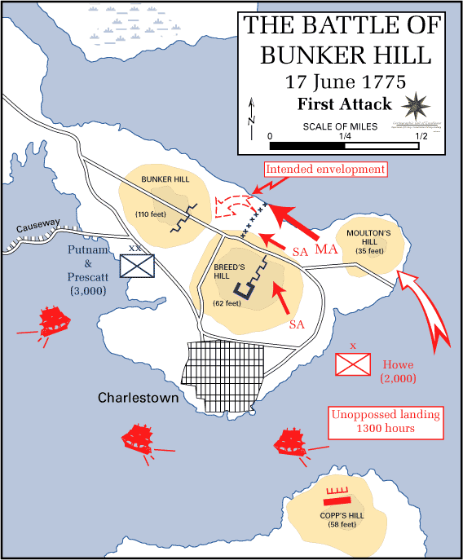

Slide 8
http://www.youtube.com/watch?v=hiIFRCk1hxY

