Slide 1
Pages 224-228
Make a timeline like the one below. Fill in each box with the event from Jackson’s presidency.
1824
1830
Lost Election. Wins Popular vote
Indian Removal Act
1828
1832
Wins Presidential Election
Forced Chickasaw to leave lands in Alabama and Mississippi

Slide 2
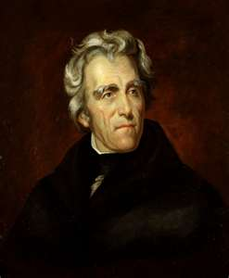
Andrew Jackson’s Presidency

Slide 3
Election of 1824
Jackson wins the popular vote but does not have the majority of electoral votes.
John Quincy Adams is elected president by the House of Reps. with Henry Clay’s support.
Jacksonians claim Adams and Clay have struck a corrupt bargain.

Slide 4
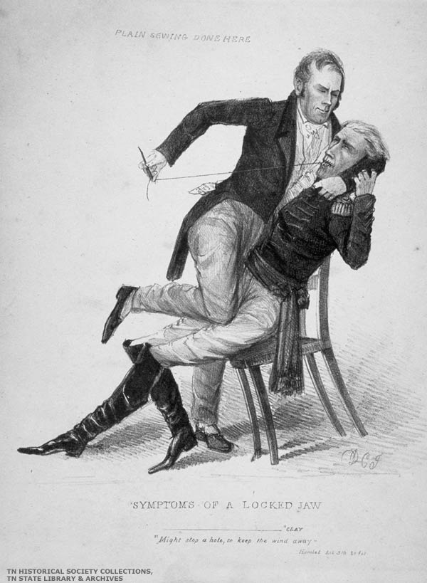
The campaign reached new heights in mudslinging and dirty campaigning. Never before had there been such an intense focus on the candidates' personalities and such little attention paid to the issues.
Henry Clay sewing Jackson’s mouth

Slide 5
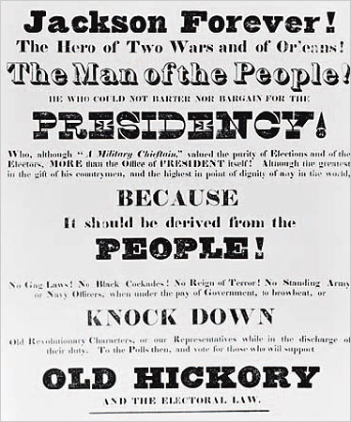
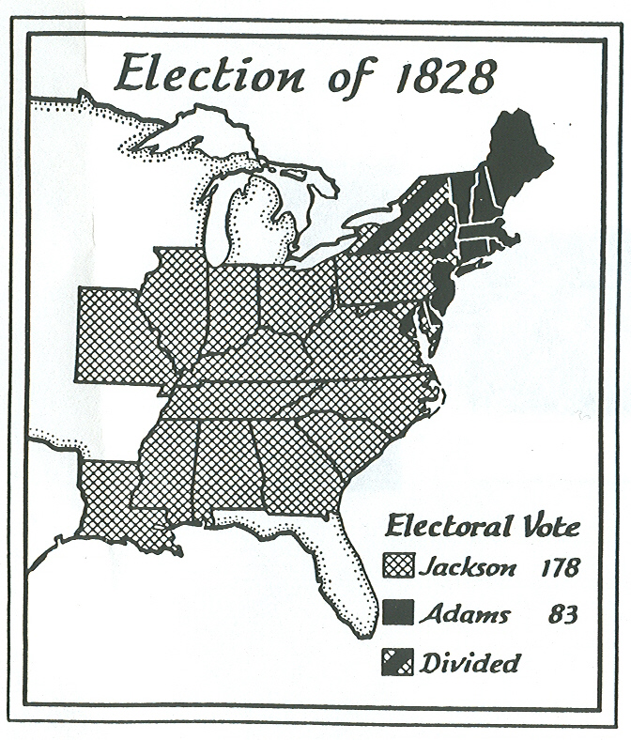
Election of 1828
Most states eased voting qualifications, no longer needed to own property.
This helps Jackson win this election

Slide 6
Jackson’s Style
He claims he is of humble origins but is reality is wealthy.
Appeals to the common citizen.
Limits appointees to federal jobs to four-year terms
Uses spoils system – replaces former appointees with own friends.
Friends become his primary advisors, dubbed “kitchen cabinet”

Slide 7
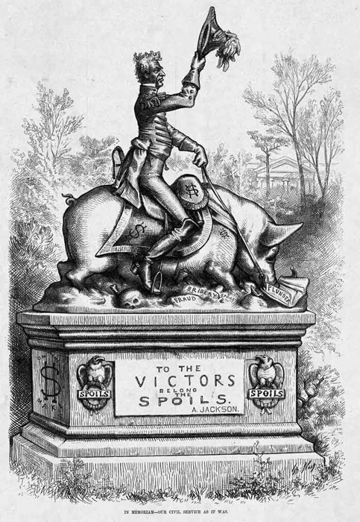

Slide 8
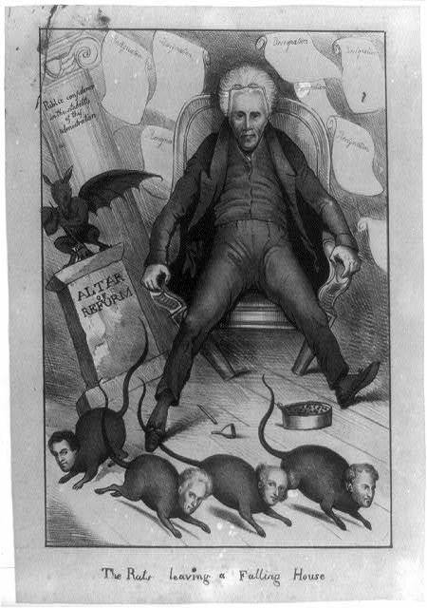
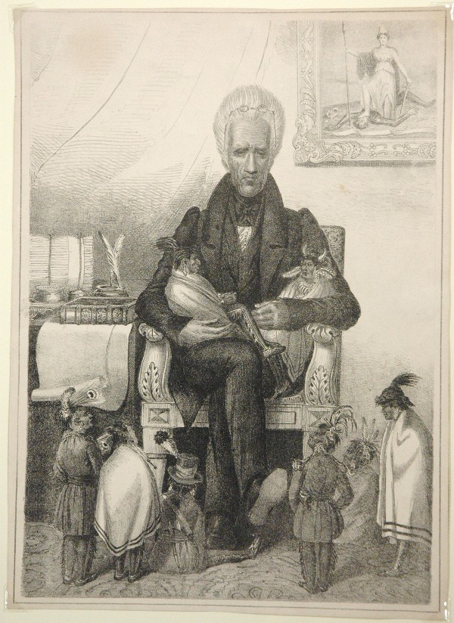
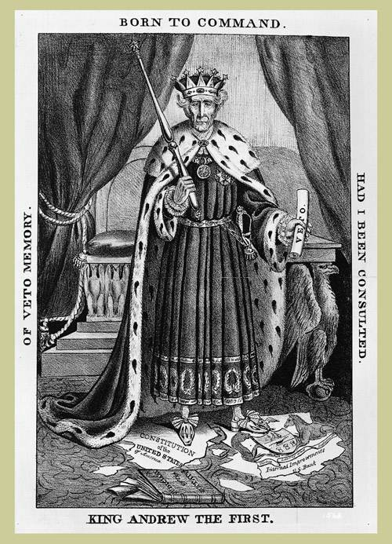

Slide 9
Jackson Vetoes the National Bank
-Jackson supports an “agricultural republic”, felt the bank improved the fortunes of an “elite circle”.
Destroyed the bank in 1832 and withdrew U.S. funds in 1833.
Resulted in the panic of 1837, which threw the national economy into depression.

Slide 10
Reasons for Abolishing Bank:
It exposed the gov. to control by foreign interests.
Served mainly to make the rich richer.
Favored Northeastern States over Southern and Western States
Banks have a history of instigating wars between nations, forcing them to borrow to pay for them.
Concentrated the nations financial strength in a single institution.

Slide 11
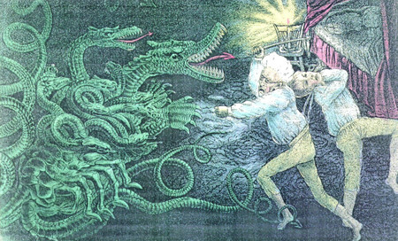

Slide 12
