Slide 1
Do now!
Why was Washington afraid of foreign alliances and political parties?

Slide 2
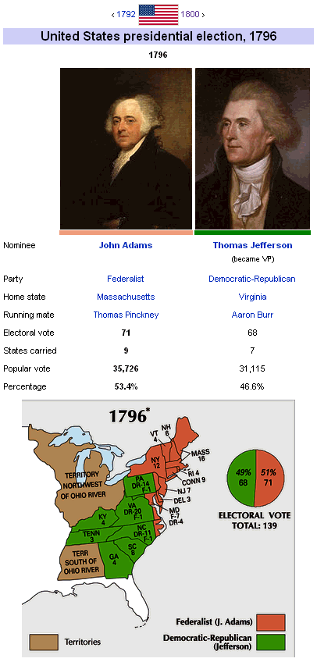

Slide 3
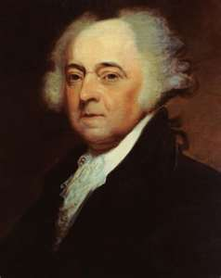
John Adams
Second President
1797-1801

Slide 4
First Crisis: A Looming war with France.
-French saw Jay Treaty with Britain as a violation of the French-American alliance.
Result = French government ordered its vessels to seize American ships carrying British goods.

Slide 5
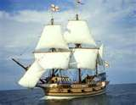
American Response: Adams sends 3 men to negotiate a solution.

Slide 6
-Plan was to meet with the French Foreign Minister, Talleyrand, but instead they met 3 lower-level officials who Adams referred back to Congress as “X, Y, Z”.
-”X, Y, Z” demanded $250,000 as payment to see Talleyrand.

Slide 7
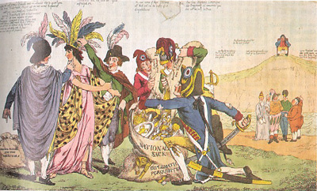

Slide 9
*Anti-French feeling at home.
*1798 Navy Dept. created and are authorized to seize French vessels.
*“Quasi-War”- lasted for 2 years.
*Feelings brought about the Alien and Sedition Acts.
*Kentucky and Virginia Resolutions stated that states had the right to void any act of Congress that they deemed unconstitutional. Issue would not last.

Slide 10
